Slide 1
UHMLG Finances 2017
Notes:
I’ve given you a print out of my financial report, but if I may, I’ll whizz you through the highlights. I won’t talk in depth about the financial details on page 1 – though I’m happy to answer any questions you might have.

Slide 2
Income Recovery: 2017
Notes:
Looking at what’s happened this year, like every year it’s our two conferences that dominate. In terms of income recovery, things are looking good – so far we’ve collected £7.3k from the Spring Forum, which is 93.1% of all the ticket sales.
And we’ve already received £3.7k – or 54.9% - of our income from the Summer Conference.

Slide 3
Income Recovery: 2016 (June 2016)
Notes:
This is actually slightly better than last year, where by the time of the Summer Conference we’d collected 89% from the Spring Forum and 52% from the Summer Conference.

Slide 4
Income Recovery: 2016 (December 2016)
Notes:
Most importantly, by the end of the year we’d collected all ticket sales money from both events (that hasn’t always happened!). I haven’t chased organisations for payments yet – I’ll be looking to do that after the summer conference.

Slide 5
Corporate Members
Elsevier
MedHand
Wiley
OUP
Wolters Kluwer
Decker IP / Eurospan
Notes:
New for this year, we’ve implemented Wayne’s suggestion of having a Corporate Membership scheme – and six organisations have taken us up on the offer. Five have paid, one I’ve only just invoiced, as they took a very long time to sort out their end of things. The offer allows them two people to attend the Spring Forum, and one person to attend the Summer Conference at an effective discount of 10%. From our point of view, we get these sponsor ticket sales guaranteed right at the start of the year, and we have just one invoice to draw up and chase.

Slide 6
Documentation
Policies Manual
Procedures Manual
Auditing
Notes:
Policies & procedures manuals are in progress. Policies cover:
Who should authorise payments (e.g. normally signatories do not authorise payments to their own institutions, or to themselves)
What expenses are covered for speakers
Auditing:
We intended to audit the accounts last year, but this didn’t quite happen
We are all set to get them audited by Richard Osborn this year
GnuCash:
I am tracking all financial transactions on GnuCash – free accounting software
This has improved my processes – though steep learning curve

Slide 7
Accounts & Status
Barclays Migration Complete
Charitable Status Question
Notes:
We have closed the Co-Op account, and now use only Barclays for our banking. This has simplified the tracking of finances, not least because I didn’t have direct access to our old Co-Op account!
Thanks to advice from Shirley Millar of the Business Librarians Association, I am now confident (don’t ask me to put a percentage on it!) that we do not need to be registered as a charity or have VAT registration: our turnover is nowhere near the £83k that necessitates VAT registration. Last year we took in £15.3k, this year we expect to take in £20k.

Slide 8
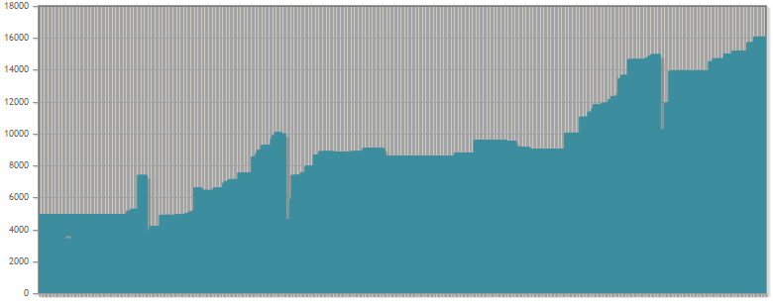
Finances: 2016 - 17
Notes:
This is the output from GnuCash: I’ve been adding all the data from this year, and have retrospectively added all the data from 2016. Things look pretty healthy, but it’s also not entirely clear what’s going on…

Slide 9
Finances: 2016 - 17
Spring Forum 2017
Summer Conference 2017
End of 2017
End of 2016
Summer Conference 2016
Spring Forum 2016
Start of 2016
Notes:
Simplified, you can see the cash reserves building up in the run up to each event, with then big payouts when we hold the events.
Note that (as we know from earlier in the presentation) not all the income for an event is collected before the event takes place.

Slide 10
Finances: 2016 - 17
Notes:
We can see there’s a significant rise in the overall balance between the start of 2016 and the end of 2017 – on the face of it, this is substantial. However, as Treasurer it’s my job to be cautious – and what I’m intently focused on are those big dips.

Slide 11
Finances: 2016 - 17
Notes:
The payouts mostly cover the venue fees for our two annual conferences – but there are also speaker fees and a few other bits and pieces too.

Slide 12
Finances: 2016 - 17
Notes:
The critical thing is that if you add together all outgoings for 2016 they came to just over £12k – that’s much more than the £4.9k we started 2016 with…

Slide 13
Finances: 2016 - 17
Notes:
…and it also far exceeds the £9k we ended 2016 with.

Slide 14
Finances: 2016 - 17
Notes:
This year’s outgoings could be in the order of £15k – so even that exceeds our current projected end-of-year balance of £13.9k.
I will admit to deliberately being a little pessimistic on our projected outgoings, what I wanted to demonstrate was why I feel it important to increase our operating balance. The good news is that we’re almost at the point where our balance could in itself entirely fund one year of our acivities, which is what I’m targeting as the ideal position to be in.

Slide 15
For 2018
Increase Attendance at Events
Target Small Net Profit
Complete First Accounts Audit
Notes:
For 2018, I want us to have strong and stable accounts:
We will need a small net profit to reach our target end-of-year balance
Note that we will most likely always be chasing our target balance as the venue fees fluctuate year to year
We need to budget carefully to maximise attendance at our events
We expect to make a modest profit in the Spring, which will offset a loss made in the Summer
We also want to ensure that the pricing structure at both events (along with the programme, of course) does everything to encourage maximum attendance and engagement
I also want to have had our accounts audited, with a process in place for annual auditing at an appropriate time of year.

