Slide 1

Financial Report to the
2018 UHMLG AGM
Ric Paul, Treasurer

Slide 2
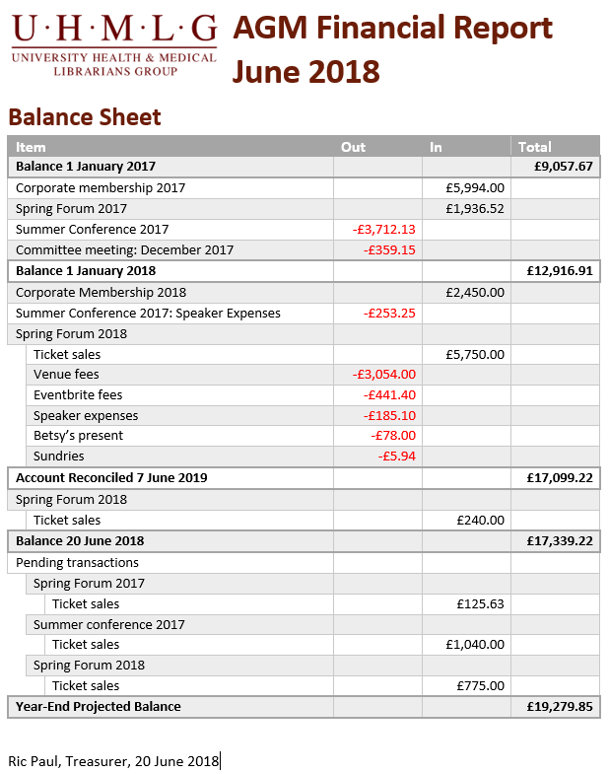
Balance Sheet

Slide 3
Balance Sheet

Slide 4
Balance and Expenses: 2015 - 2018

Slide 5
2017 Events: Income Recovery: June 2017

Slide 6
2017 Events: Income Recovery: June 2018

Slide 7
2018 Events: Income Recovery: June 2018

Slide 8
Financial Planning for 2019 Onwards
Ticket price review
Attendance promotions
Invoice chasing

Slide 9
Other News
Mandate changes
Auditing
Account reconciliation
GDPR

