Slide 1
A SWOT analysis of the library space in the year of generative AI
Andrew Cox, Information School, University of Sheffield, UK
a.m.cox@sheffield.ac.uk
Notes:
Thank you for the invitation to speak to you
Thank you for the opportunity to discuss this topic with you.

Slide 2
The Information School University of Sheffield, UK

Slide 3
What word or words would describe your feeling about Artificial Intelligence?
Wooclap.com
Event code: ADASTL

Slide 5
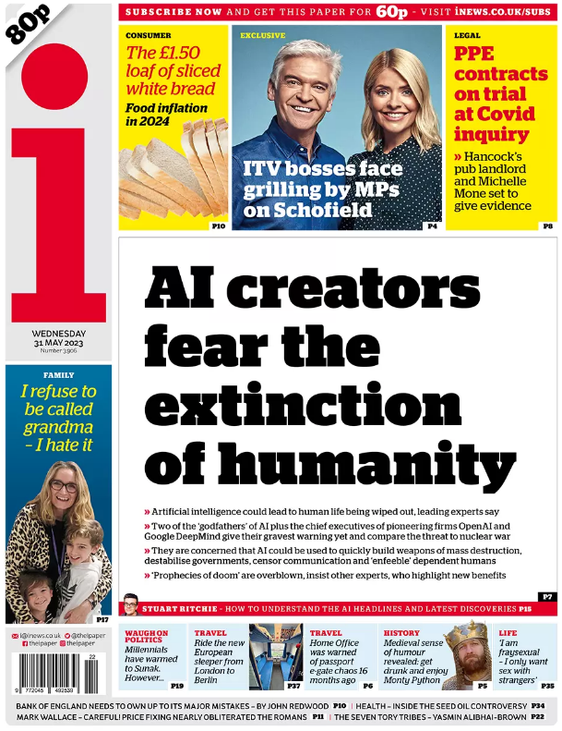
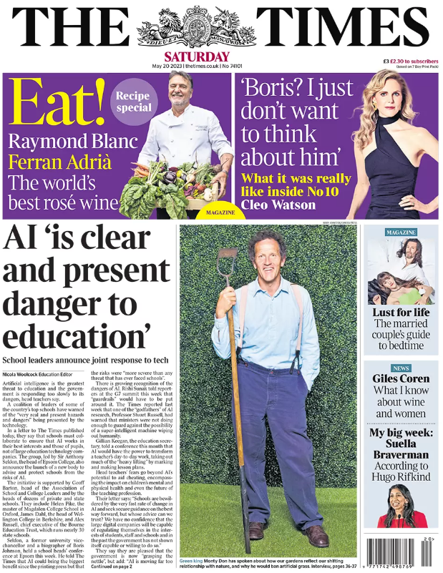
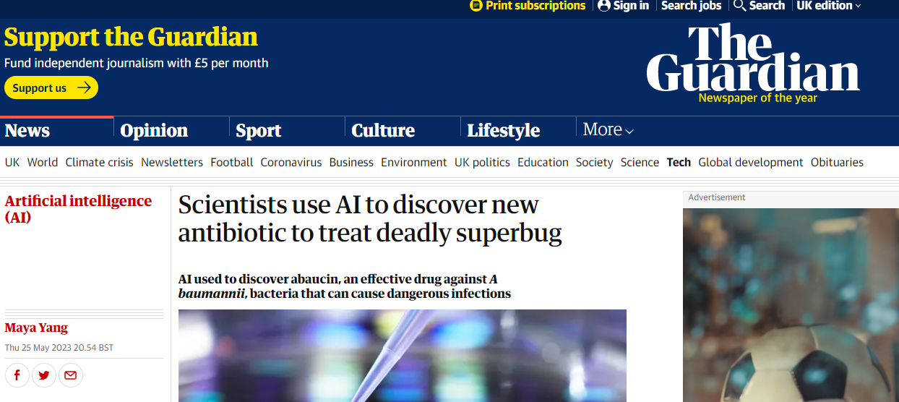

Slide 6
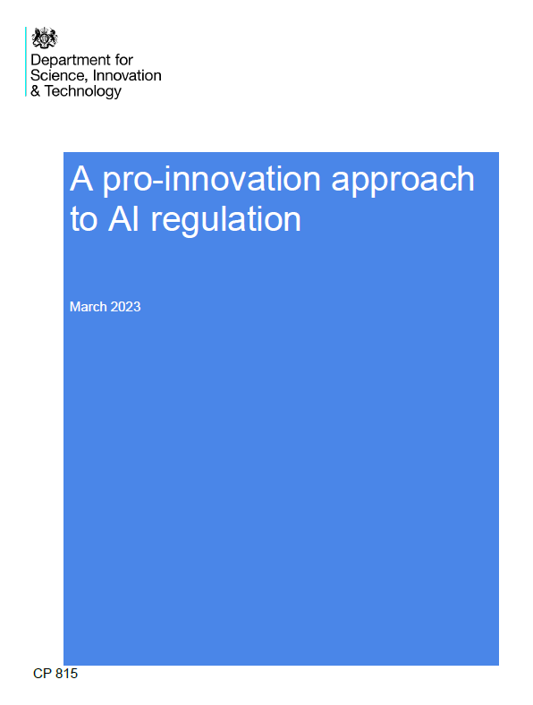
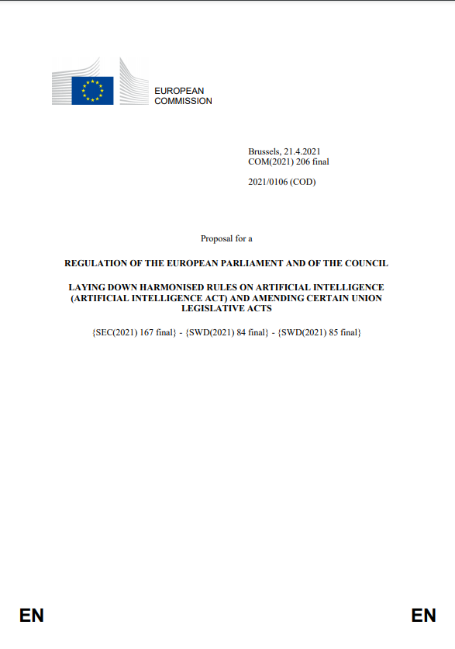
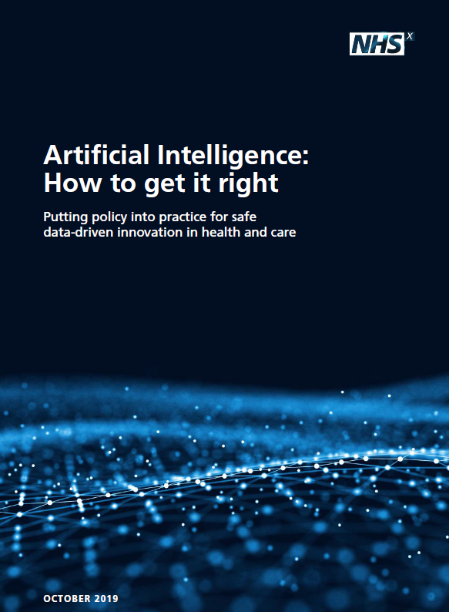
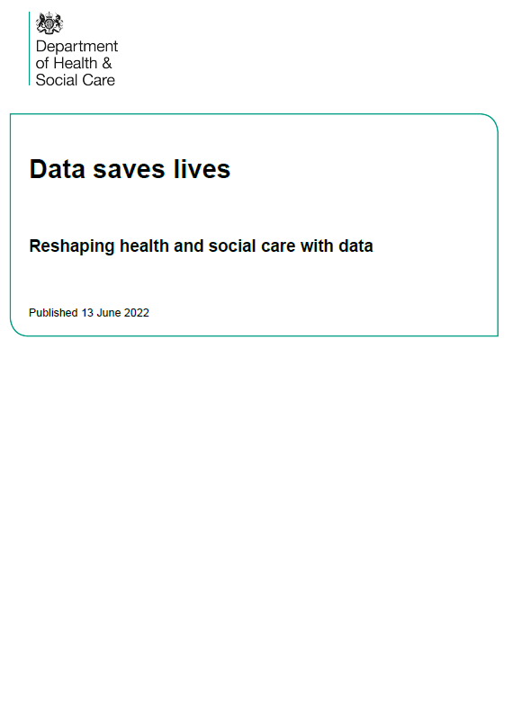
Artificial Intelligence: a strategic priority
Notes:
In Policy: it’s a national, organisation, sector body priority.
OECD AI policy observatory has hundreds of documents – 55 for UK alone
New taskforce too!
https://www.gov.uk/government/news/initial-100-million-for-expert-taskforce-to-help-uk-build-and-adopt-next-generation-of-safe-ai

Slide 7
Agenda for talk
Explain AI and its uses in health library context
Reflect on possible strategic responses to AI
Develop a SWOT for libraries
Reflect on strategic options
Prompt you to share thoughts via wooclap that we can put into the final slides for circulation

Slide 8
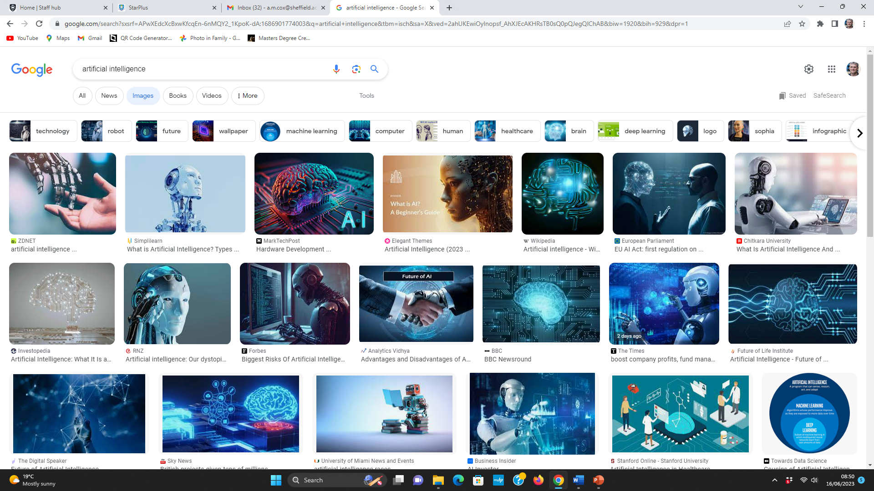
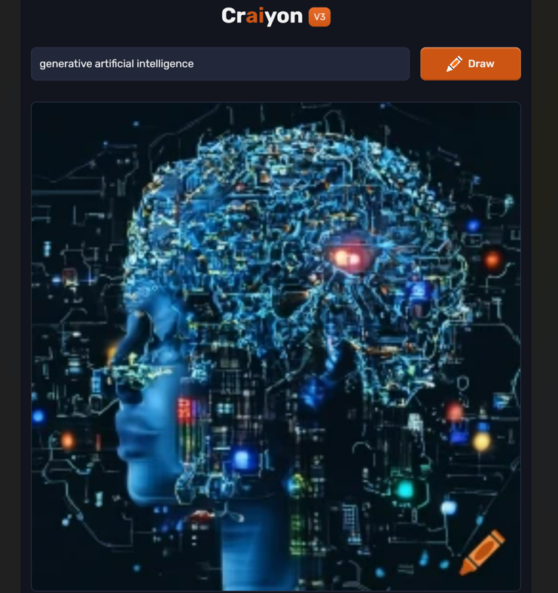
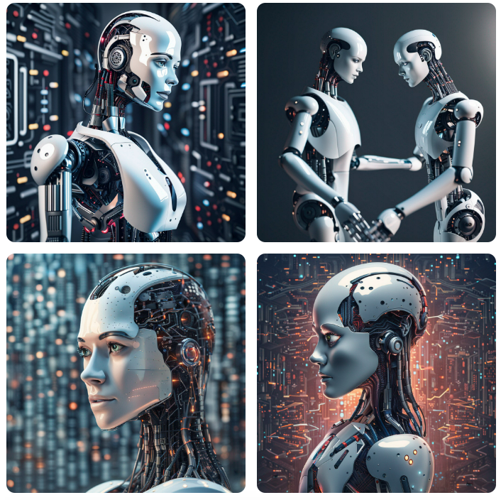
Artificial Intelligence
Notes:
Crayon
Stable diffusion

Slide 9
Formal definitions
“AI is the ability of a computer system to solve problems and perform tasks that would otherwise require human intelligence.” (US National Security Commission on AI, 2021)
A suite of technologies and tools that aim to reproduce or surpass abilities in computational systems that would require ‘intelligence’ if humans were to perform them. This could include the ability to learn and adapt; to sense, understand and interact; to reason and plan; to act autonomously; or even create. It enables us to use and make sense of data.” (UKRI, 2021: 4)
“Machines that imitate some features of human intelligence, such as perception, learning, reasoning, problem-solving, language interaction and creative work (UNESCO, 2022: 9).
Simply put, AI is a collection of technologies that combine data, algorithms and computing power.” (European Commission, 2020: 2)

Slide 10
Chat GPT’s definition (for a general audience in 100 words)
“Artificial Intelligence (AI) refers to computer systems designed to perform tasks that would typically require human intelligence. It encompasses various technologies that enable machines to understand, learn, reason, and make decisions like humans. AI can analyze vast amounts of data, recognize patterns, and solve complex problems. It includes subfields like machine learning, which allows systems to improve their performance through experience, and neural networks, which simulate the human brain's structure and functions. AI applications range from voice assistants and self-driving cars to personalized recommendations and medical diagnoses. Its potential impact is vast, shaping industries, enhancing efficiency, and transforming our daily lives.”

Slide 11
“You wake up, refreshed, as your phone alarm goes off at 7:06am, having analysed your previous night’s sleep to work out the best point to interrupt your sleep cycle. You ask your voice assistant for an overview of the news, and it reads out a curated selection based on your interests. Your local MP is defending herself—a video has emerged which seems to show her privately attacking her party leader. The MP claims her face has been copied into the footage, and experts argue over the authenticity of the footage. As you leave, your daughter is practising for an upcoming exam with the help of an AI education app on her smartphone, which provides her with personalised content based on her strengths and weaknesses in previous lessons.
On your way to work, your car dashboard displays the latest traffic information, and estimates the length of your journey to the office, based on current traffic conditions and data from previous journeys. On arrival, you check your emails, which have been automatically sifted into relevant categories for you. A colleague has sent you several dense legal documents, and software automatically highlights and summarises the points most relevant to a meeting you have later….”
House of Lords Select Committee on AI (2018) AI in the UK: Ready, willing and able
Notes:
Present/Near future
General help across many domains – but narrow AI – including with information –
but also some worries eg educ equality, legal documents quality

Slide 12
The familiar face of AI
Spam filtering
Plagiarism detection
Transcription and captioning
Translation
Recommendation
Search
Predictive text
Many benefits in terms of access to knowledge
Familiar problems:
Inaccuracy
Bias eg which languages translated
Privacy concerns around recommendation
Filter bubbles

Slide 13
The old new face of AI in libraries? Descriptive AI
10,000 video files with only titles to search on
Unrealistic to manually enhance records
AI might offer better search
Based on voice recognition (as per captioning) provide a transcript of things people say that can be used to search
Based on image recognition
Identify types of objects (eg cars, houses)
Identify places / people
Identify music
Will not be 100% accurate
Might be hard to explain it how works
Might be systematically inaccurate, eg if trained on majority voices (eg English people speaking English, not a broad accent or another language) – not bias in AI, bias in data or how data is handled – but problem may be deeper in whole idea of classification of peoples problematic
Guidelines eg via Lee (2022) https://arxiv.org/abs/2207.02960
Cost of systems v skills to build

Slide 14
Definition: AI for information professionals: “Wide and deep” impact?
Using AI in our own daily work
Using AI tools in your own work, eg book ordering, summarising texts… etc
Robotic process automation of backend processes
Using AI in our own services to users
Supporting use of AI built into third party search tools – choosing and selecting such tools
Applying machine learning to organisational datasets
Text mining the literature or creating metadata special collections of text, images, audio - any data at scale
Eg ML applied to library heritage collections, eg oral histories, handwritten manuscripts, image collections
Using AI tools within Systematic Literature Review process
Developing a chatbot or voice assistant for information service users
Exploiting generative AI
…
Creating a robot animal petting zoo!
Smart library spaces
Energy saving
Surfacing relevant content in different spaces
Supporting a community of data scientist users
Providing data e.g. from special collections or locating/ licensing external data sets for analysis + data governance and stewardship
Advice on tools
Developing training data for machine learning
Creating a community of data scientists or simply participating
Folding AI / data literacy into IL
Promoting data and AI literacy across an organisation or with public
Could be aspect of citizen awareness of AI in search
Could be in a specific context, eg students using translation tools or writing tools or other research tools (like rabbitai )
Supporting wider use of AI in the organisation
Input to your organisation’s adoption of AI, e.g. in procurement, training, data capture etc
Using AI to monitor/ predict/influence user behaviour
E.g. applying sentiment analysis to social media responses to information services, trying to predict occupancy of library from weather

Slide 15
From a recent rapid pre-event survey (N=68)
Promoting AI (and data) literacy for users – 50% planned; 9% pilot or mature service
Library specific chatbot – 22% planned; 16%
Text and data mining support 21%; 9%
Knowledge discovery of collections 19%; 13%
An institutional chatbot 12%; 9%
Automation of systematic reviews 15%; 4%
Supporting institutional data scientist community 12%; 12%
Library user behaviour prediction 6%; 1%

Slide 16
New new face of AI: Generative AI as general AI
Chat GPT
Draft a short or long piece of text eg essay or cover letter for job application or a tweet or a policy document
Answer questions
Write code
Solve a maths problem
Create content in multiple languages
Supply a recipe
Prompting a new paradigm of search? Search in natural language and get results in the form of an answer, not a set of resources
Proliferation of GPT based applications for “research” - https://www.futurepedia.io/
Other Large Language Models, specifically for medical contexts: eg
Med Palm 2
MedAlpaca
Why has Generative AI created such a strong response
It is general AI
Its appealing to users because its easy to use
“Sudden” appearance
Huge investment and development around generative AI
Its directly used in search
Wider moral panic about AI
Notes:
https://en.wikipedia.org/wiki/ChatGPT

Slide 17
Health applications of generative AI
Streamlining repetitive tasks
Policy drafts
Summarisation of texts for literature reviews
Lay summaries or translations of texts for patients
Clinical decision support
Simulated patient interactions – for training

Slide 18
Ethical challenges of AI, example: Chat GPT
Makes biased statements, eg GPT biased about gender and race
“Hallucinates” information which is inaccurate, threatening trust in information – fabricates citations – cannot be cited
Will accelerate content creation explosion – leading to even more challenges of information overload
Is unexplainable because it is far from open about what data it is based on or how it works
Privacy is at risk if you share your data with it – many companies blocking use due to fear of loss of data
Violates copyright by using our text and data on the Internet
Threatens jobs, eg journalists, editors and marketing
Is available to people with money to subscribe, disadvantages those without
Was developed by exploiting very low paid Kenyan workers to detoxify content
May not be environmentally sustainable
Reveals the disruptive power in the hands of big Tech companies
There are alternatives to Chat GPT, some health specific
It is both about
How to use it ethically?
But more broadly ask questions about how ethical was its creation?- its not “just a tool”
Critical IL and algorithmic literacy has never been more needed!
Notes:
New Wikipedia – same issues?
Train tool on chat GPT
Summarising some unstructured qualitative data
Brainstorming
First drafts
It’s a language model not a single point of truth
Some guard rails in place
Bloomberg Chat GPT
Its EASY

Slide 19
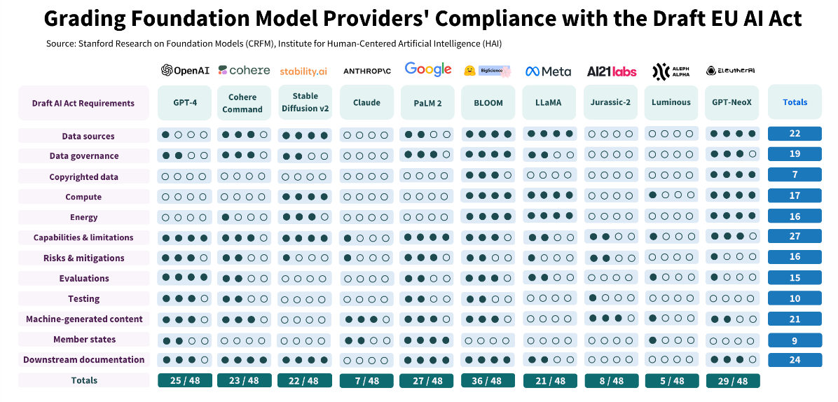
https://crfm.stanford.edu/2023/06/15/eu-ai-act.html

Slide 20
What algorithmic literacy is in the context of Chat GPT, Bing and Bard, and related apps
Learning how to use it effectively, by experiment and reading reviews
Learning to use it reflectively
Protecting privacy
Asking who owns, develops and profits from it
Using it ethically
Are you permitted to use it in this context, eg under what conditions does your institution permit its use?
Acknowledge it’s use appropriately, eg there is APA citation guide https://apastyle.apa.org/blog/how-to-cite-chatgpt

Slide 21
MS Co-pilot
Promised in MS Co-pilot
Convert a word document to a presentation, allowing tweaking of content and tone
Do preliminary analysis on data and write narrative
“Summarize the emails I missed while I was out last week. Flag any important items.”
“Summarize what I missed in the meeting. What points have been made so far? Where do we disagree on this topic?”
“Create a table of pros and cons for [topic being discussed]. What else should we consider before making a decision?”
Makes more of functions of office visible
Presumably adaptivity to your needs
Interact via voice
Anticipated issues with Co-pilot
Need to check for errors – who is responsible for errors?
May be biased in errors, eg misrecognising some speech patterns
Probable variable reliability of different operations (eg document conversion v meeting analysis)
Will require prompt engineering skills
Need to point at have access to relevant documents – silos of information will remain problem
Need to manage politics of document creation
Forces you to keep all material accessible to co-pilot, eg MS platform
Acceleration of demands on staff and increased surveillance
Productivity agenda

Slide 22
AI as a myth: An extractive global industrial complex
How much energy does it use?
How much raw material does it use?
How much does it rely on clickworkers and other ghost work?
How much unpaid labour/ data are we contributing?
Who profits? How does it link to global inequalities?
(Crawford and Joler, 2018; Crawford, 2020)
Notes:
As an industrial complex

Slide 23
Balanced response
Pessimism
Bias and impact on social equality
Impact on trust in information and content overload
Power of Tech companies beyond control of society
Optimism
Enhanced access to knowledge
Easier information creation
Potential regulation
Relevance of professional skills around data and commitment to information literacy
Need for greater agility?

Slide 24
Which uses of AI are most relevant to your own work?
Using AI tools in everyday knowledge work: eg transcription, translation, summarisation, generating draft text
Supporting users to pick best and safest AI tools for their work
Creating a library chatbot
Inputting to the knowledge base for a trust wide chatbot
Creating a community for data analysts and data scientists
Folding data and algorithmic literacy into IL training
Introducing descriptive AI tools into search
Wooclap.com
Event code: ADASTL

Slide 25
Which of these barriers to using AI is the toughest in your context, and why?
Privacy and confidentiality issues
There are more important priorities
Issues of bias
IT own the agenda
Security concerns
Lack of relevant technical skills among staff
Data quality issues
Cost of commercial systems
Value of AI remains unproven
Implementation challenges
GDPR and data governance
Wooclap.com
Event code: ADASTL

Slide 26
A guide to good practice for digital and data-driven health technologies (2021)
Review the Data Ethics Framework and abide by the principles
Ensure that the product is designed to achieve a clear outcome for users or the system *
Ensure that the product is easy to use and accessible to all users *
Ensure that the product is appropriately tested and is fit for purpose
Ensure that the product is clinically safe to use
Demonstrate that the product collects, stores and processes users’ information in a safe, fair and lawful way
Be fair, transparent and accountable about what data is being used
Be transparent about the limitations of the data used *
Make security integral to the design and ensure that the product meets industry best practice security standards
Ensure that the product meets all relevant regulatory requirements
Ensure that the product makes the best possible use of open standards to ensure data quality and interoperability
Generate evidence that the product achieves clinical, social, economic or behavioural benefits
Define the commercial strategy

Slide 27
Responding strategically

Slide 28
AI’s impact on jobs
“Generative AI will upend the professions” Susskind and Susskind – FT 18.06.2023
Some scholars predict the replacement of professionals (Susskind and Susskind, 2015)… others emphasise the vulnerability of “routine” jobs (Frey and Osborne, 2017)… others point to task not role replacement (Huang and Rust, 2018)
Willcocks (2021): it’s a slow process & not just AI – consider SMACIT
AI and the productivity agenda
Replaced
Dominated
Divided
Complemented
Augmented
Rehumanized
(GPAI, 2020)
Differences by sector

Slide 29
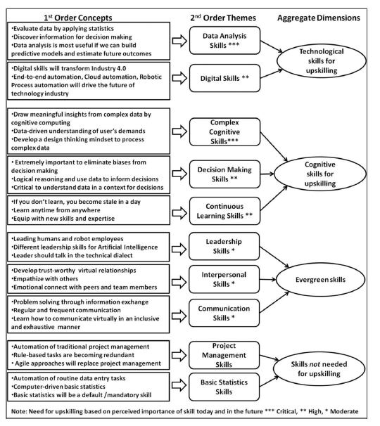
Jaiswal et al., 2022

Slide 30
Fusion Skills (Daugherty & Wilson, 2018)
Rehumanizing time- The ability to increase the time available for distinctly human tasks like interpersonal interactions, creativity, and decision making in a reimagined business process.
Responsible normalizing- The act of responsibly shaping the purpose and perception of human-machine interaction as it relates to individuals, businesses, and society.
Judgment integration- The judgment-based ability to decide a course of action when a machine is uncertain about what to do.
Intelligent interrogation- Knowing how best to ask questions of AI, across levels of abstraction, to get the insights we need. Prompt engineering.
Bot-based empowerment- Working well with AI agents to extend your capabilities, and create superpowers in business processes and professional careers.
Holistic melding- The ability to develop robust mental models of AI agents to improve business process outcomes.
Reciprocal apprenticing
(1) Performing tasks alongside AI agents so they can learn new skills;
(2) on-the-job training for people so they can work well within AI-enhanced processes.
Relentless reimagining - The rigorous discipline of creating new processes and business models from scratch, rather than simply automating old processes.

Slide 31
AI relies on data – our data knowledge/ attitudes are relevant
How to find data in a complex information landscape
Understanding of data quality and data governace
The emphasis on the value of sharing, openness and interoperability
How to understand the provenance and quality of that data to determine its usefulness
What data can be used for and what not (copyright etc)
How to describe data using standards
Maybe need to supply richer data about provenance
How to pick tools to do analysis
How to store, preserve (or destroy) derived data

Slide 32
SWOT analysis
Strengths
We know about user need
Our service orientation
AI is based on data – we should know about data
Our willingness to learn
We share knowledge across the sector
Willingness to collaborate
Ethical principles
Weaknesses
User need and behaviour may be shifting
We don’t use the language of data enough
We have many other pressing priorities
Librarians are seen through stereotypes
Lack of confidence
Value conflicts with AI
Technical skills are lacking
NHS infrastructure

Slide 33
SWOT analysis
Opportunities
Improved access to knowledge
Uncertainty – so people want advice
Information trust is at risk – libraries are trusted
AI key dimension of digital workforce
A vision for AI
Threats
Emotions around AI
Demand for new ways to interact with information
Speed of change
Power of big Tech
Productivity agenda

Slide 34
Is there anything you would add to this SWOT?
Wooclap.com
Event code: ADASTL

Slide 35
A strategic response to AI?
Wait and see what happens in sector
Collaborate with other libraries
Wait and see what happens in the trust
Collaborate with other units in the organisation
Recruit new staff
Study best in sector
Engage with users to see how they are using AI
Run proof of concept projects
Experiment individually
Talk to the system suppliers
Wooclap.com
Event code: ADASTL

Slide 36
What areas of skills development are needed?
General understanding of AI
Coding
Statistics
Open mindedness and willingness to learn
Data management and governance
Knowledge of user behaviour and need
A vision of how to use AI
Collaboration and influencing skills
Professional ethics
Wooclap.com
Event code: ADASTL

Slide 37
Competencies we need to develop

Slide 38
Competencies we need to develop

Slide 39
Searching for analogies, is AI like…?
The calculator
Wikipedia
Google search and Amazon recommendation
Text messaging (with predictive text) and spell checking in word processors
The invention of the Internet
The power loom (and we are the hand loom weavers!)

Slide 40
The impact of AI, machine learning, automation and robotics on the information professions: A report for CILIP https://www.cilip.org.uk/general/custom.asp?page=researchreport
Notes:
Next steps:
Go back to report for more specific points
Look at readings for cilip ai/ corporate & KM
Look at ethics stuff
Comb through new links
Hank Malik – neglect of KM / digital transformation / analysis
IT ownership not IM/KM

Slide 41
JISC blog entry: “Library strategy and AI”
https://nationalcentreforai.jiscinvolve.org/wp/2023/06/05/library-strategy-and-artificial-intelligence/
https://docs.google.com/document/d/15pKk2rJh9HHTqA6O7PWNY_7VYHIW-wc9AkV22bkX-R4/edit#heading=h.42zb7zl1anug

Slide 42
IFLA SIG on AI: 23 resources to get up to speed on AI in 2023
https://www.ifla.org/23-resources-to-get-up-to-speed-on-ai-in-2023/

Slide 43
Generative AI for library and information professionals (draft)
https://www.ifla.org/generative-ai/

Slide 44
AI will be a major theme at WLIC 2023, in Rotterdam
https://2023.ifla.org/

Slide 45
AI4LAM
https://github.com/AI4LAM
Fifth fantastic futures conference is Vancouver in November – call for papers is now out!
Regular online discussions

Slide 46
Thank you … do you have any questions?

