Slide 1
Decolonising global health, one systematic search at a time
Jane Falconer
jane.falconer@lshtm.ac.uk
@falkie71
Notes:
In this talk I’m going to describe a project we ran to see if we could measure any impact on systematic reviews we’ve collaborated on of including discussions on decolonisation, focusing on three areas of the systematic search, while creating the draft search strategy or before.
But first, I’m going to give you some definitions and background, as it’s important we are all starting from the same understanding. I should also say that when it comes to decolonising, I’m very much still learning, I recognise I’m looking at this from a very privileged position. I’d be happy to have a discussion afterwards with anyone who wants to about any of what I’m about to say.

Slide 2
Decolonising at LSHTM
“Decolonisation is not ‘integration’ or ‘inclusion’ by tokenisation of cultures or people. It is about an institutional cultural shift to identify colonial patterns and systems, both within the institution and in global health, and to challenge the dominance of those systems. This can be within teaching, research or in broader citizenship. It is the making of space for alternative modes of knowledge and the valuation of experience. It is thinking about what constitutes ‘knowledge’ and understanding our own ingrained cultural perceptions in a meaningful way, then acting to change them. It is a continual process of ‘unlearning’.”
- LSHTM Decolonising the Curriculum Toolkit

Slide 3
Decolonising global health
“Globally, histories of slavery, redlining, environmental racism and the predatory nature of capitalism underpin the design of global and public health systems, resulting in structural, racial and ethnic inequities within BIPOC communities.”
“The pandemic response reveals with stark and sobering clarity that current paradigms of global health equity are insufficient in counteracting structural oppression. By focusing on individual risk factors and siloing funding based on disease, global health agendas—including pandemic responses—ignore how health risks are shaped structurally by laws, policies and norms, ranging from regional trade agreements and immigration policies to racial discrimination and gender-based violence. Structural inequities reproduced within the global health system itself—such as over-representation of affluent white men from HICs in global health leadership positions—highlight the lack of critical engagement with the geopolitical determinants of health disparities.”
- Büyüm et al 2020
Notes:
BMJ Global Health

Slide 4
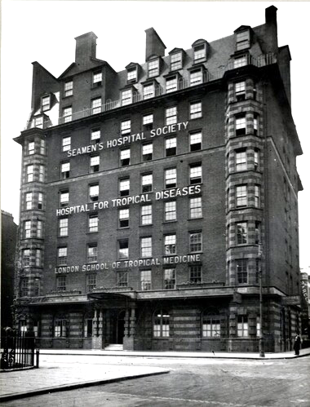
LSHTM and the British Colonial Office
Formed in 1899 as the London School of Tropical Diseases
Funded by the British Colonial Office
In 1924 it becomes London School of Hygiene & Tropical Medicine
In 1925 LSHTM joins the University of London
Notes:
School founded to train staff for the British Colonial Medical Service and the British Foreign Office.
Only in 1925 were these links formally broken and qualifications were issued by the University of London.
This is a picture of the School’s second home in Endsleigh Gardens in London. This building is now UCL’s student union.
Patrick Manson was Chief Medical Officer to the Colonial Office

Slide 5

Decolonising LSHTM
“It is largely to its role in British colonialism that the LSHTM owes its current power and position as a leader in health research and teaching.”
-Hirsch 2022, pg7.
“The colonial attitudes inherent in LSHTM’s historical mission negatively impact students and staff of colour today.”
- Nous Group 2021, pg3
Notes:
The past 3 years at the London School of Hygiene & Tropical Medicine have been eventful. Not just because the School was heavily involved in providing scientific advice to the UK government during the COVID pandemic, or because we got a new director, but because a report published by the students shed a light on unacceptably high instances of racial and colonial attitudes among academic and teaching staff. The new Director commissioned two reports to investigate. The first, authored by Lioba Hirsch traced the School’s colonial beginnings and it’s rise to prominence within public and global health research. The second, authored by the independent Nous Group, reviewed the School’s history and current practices relating to race equity and provide recommendations. The institution has made both reports available Open Access and I’ve included links to them both in the references.

Slide 6
Tackling these issues at LSHTM
Decolonising the curriculum
Equitable partnerships strategic priority
Equity, Diversity and Inclusion Strategy
LSHTM values and behaviour framework

Slide 7
Tackling these issues at LSHTM LAORS
Decolonising the archives
Decolonising the collections
Decolonising our teaching materials
Adopting inclusive recruitment practices
Decolonising literature searching

Slide 8
What is a systematic review search?
A systematic review attempts to collate all the empirical evidence that fits pre-specified eligibility criteria in order to answer a specific research question. It uses explicit, systematic methods that are selected with a view to minimizing bias, thus providing more reliable findings from which conclusions can be drawn and decisions made. Systematic review methodology, pioneered and developed by Cochrane, sets out a highly structured, transparent and reproducible methodology. This involves: the a priori specification of a research question; clarity on the scope of the review and which studies are eligible for inclusion; making every effort to find all relevant research and to ensure that issues of bias in included studies are accounted for; and analysing the included studies in order to draw conclusions based on all the identified research in an impartial and objective way.
- Lasserson TJ et al 2022.

Slide 9
Decolonising SR literature searching
Asking the right questions
Actively looking for diverse voices
Notes:
Asking questions
Which assumptions underlie the research
Involving stakeholders
Critically examining which regions/countries are under investigation
Actively looking for diverse voices
Deliberately looking for locally-published and authored literature
Including non-English language literature
Treating all authors/journals the same.

Slide 10
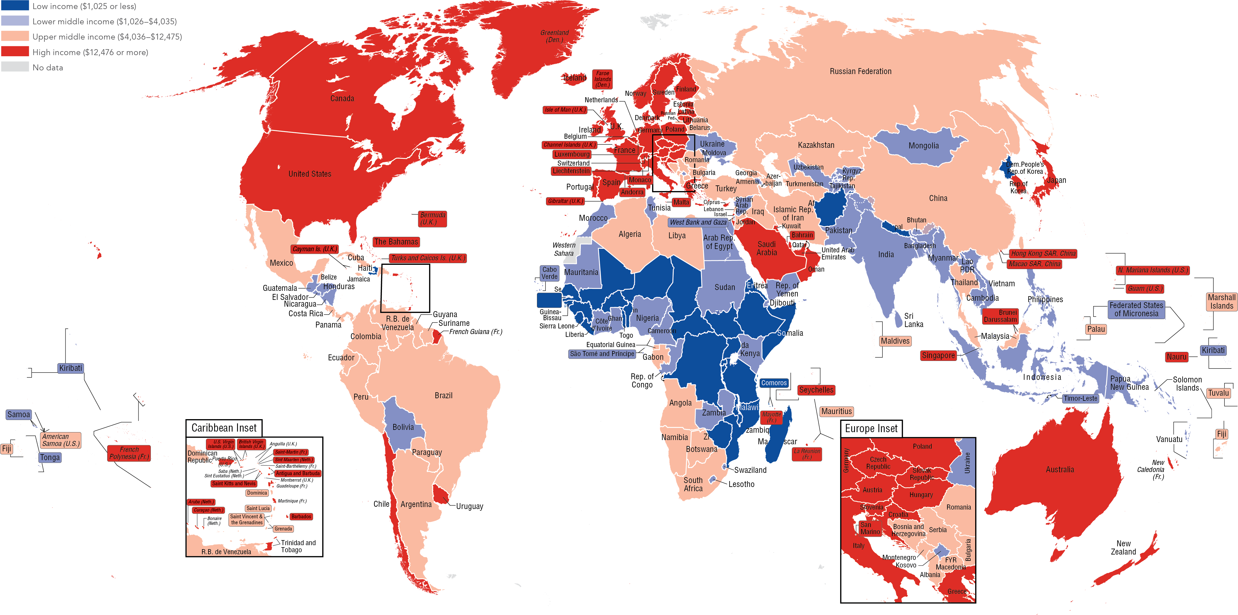
Think carefully about the countries/regions included
- Lencucha & Neupane, 2022; Khan et al, 2022.
Image from: https://datatopics.worldbank.org/sdgatlas/archive/2017/images/figures-png/WLD-income-map.png. Licensed under a CC BY-NC-SA 3.0 license.

Slide 11
Literature published in English
Proportion of non-English results for a search for malaria* in the title or abstract across 6 literature sources
Searches run 2021-11-17
Notes:
There is not one source which contains all of the information on a topic. You will have to search in a variety of sources to be comprehensive. In the past, when we have searched for information, we have concentrated on the big biomedical databases, such as Medline (also pubmed) and Embase. However, these are both biased towards journals which are published in N America and Europe. They don’t give a truly global view of a topic. When we’re advising students we recommend they search 4-5 databases if they’re doing a systematic review type project.
On this slide we can see the results of a search for malaria in 6 different databases, showing the proportion of results in English or non-English. Less than 10% of the results in the top 3 databases (Medline, Embase, WoS) was in a language other than English. Even SciELO, which is a database which specializes in collecting information published by researchers from Spanish or Portuguese speaking countries, over half of the articles are in English. Where you search has a big impact on the results you retrieve.
I should say here that my previous analysis of the malaria authors and funding may not be as skewed as we originally thought. That analysis was done on the Web of Science, where we can see 97% if the retrieved papers were in English. There will be lots more information out there, it’s just not in that source.

Slide 12
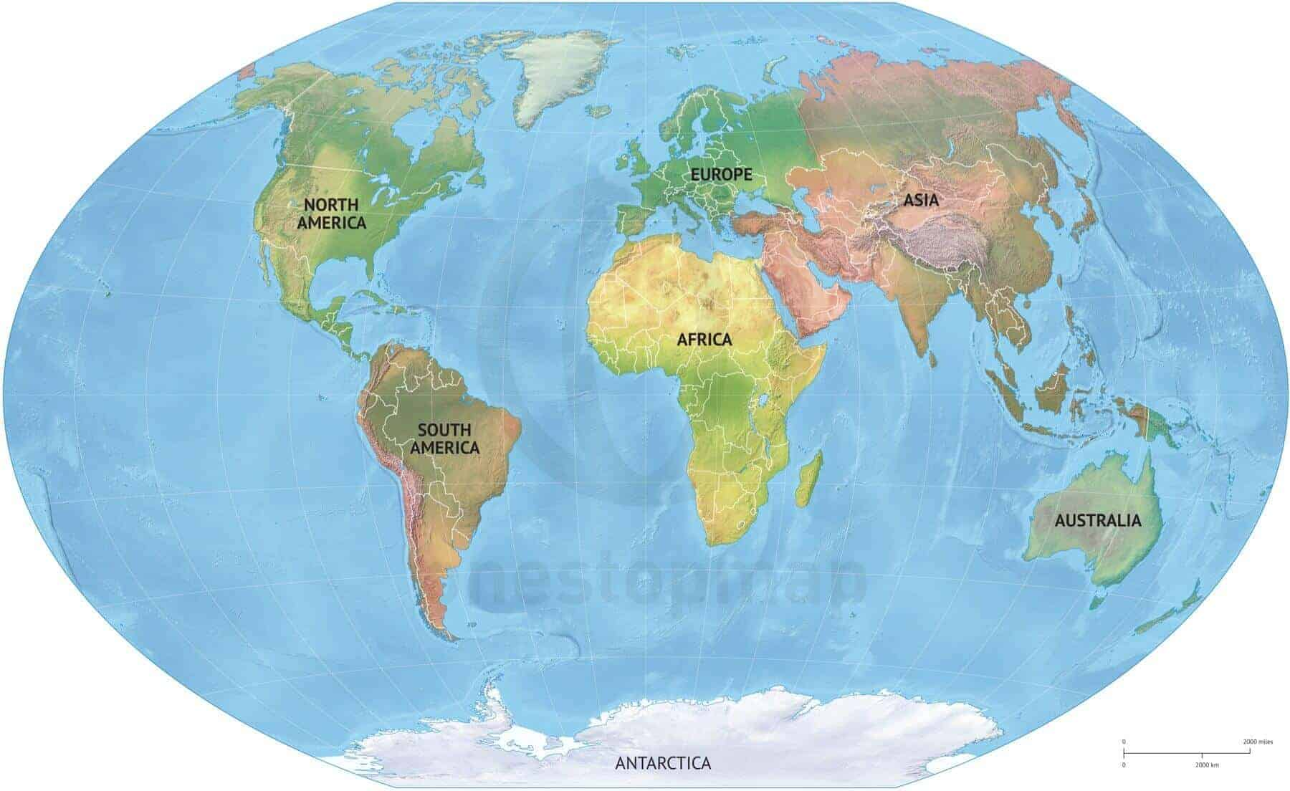
Expand sources to include information from the Global South
African Index Medicus
African Journals Online
Africa-Wide Information
AfricArXiv
IMEMR
Bangladesh Journals Online
IMEMR
IMSEAR
India Database
IndiaRxiv
IndMed
J-Stage
Mongolia Journals Online
Nepal Journals Online
PakMediNet
Sri Lanka Journals Online
Vietnam Journals Online
WPRO
SciELO
LILACS
Central American Journals Online
Redalyc
Global Index Medicus
Open Access Theses and Dissertations
Global Electronic Theses and Dissertations
Google/Google Scholar
- Curry & Lillis, 2018; Mason & Merga, 2021; Levay et al 2022

Slide 13

Remove language limits
Shenderovich et al 2016; Chaabna et al 2020.
Notes:
But does it make any difference to the end results in a systematic review if you choose to include only English language results? This is a topic of some debate in the literature, but I would argue that you’re asking the wrong question. You can’t know the answer to that unless you run a search both with and without non-English language papers and see what you may miss. If your aim is to be comprehensive and find all the relevant studies on a topic, how can you justify ignoring a potentially large number of studies?
I’ll highlight some of the recent research on this (references are on a slide at the end)
A study by Dobrescu et al found that reducing searches to English language only may be ok for rapid reviews or low-resourced reviews in MOST medical topics. Note how many qualifiers are used in that statement. However, a study by Shenderovich et al in 2016 found that 15% of relevant studies on a topic focusing on low and middle income countries was in a language other than English. 2/3 of those were only retrieved by using regional databases. Chaabna et al found similar results looking for information on the Middle East and North Africa.
Therefore, our recommendation has changed and we now encourage reviewers to include specialist regional or non-English language databases in their list of sources, especially if their topic is relevant in countries where English isn’t an official language or if you are trying to get a global or regional perspective on a topic.

Slide 14
Objectives of this study
Has incorporating these three recommendations made any difference to the diversity of papers included in systematic reviews?

Slide 15
Methods
Collect raw data
Data from searches without removing duplicates, coded by source
Code data (Bethel et al)
= paper retrieved by database search
Analyse data
List of included studies
List of included sources
= paper in database on search date but not retrieved
= paper not indexed in database
= database not searched
Data from published/in press SRs
Notes:
Excluded any included studies which were not found in the bibliographic literature search (ie from citation searching, asking authors, web searching)

Slide 16
Results
Notes:
Included studies are not random. They are the studies which I have run the searches on, so have the .ris files, have completed screening so have the included references, and who I have discussed the three recommendations with prior to searching.

Slide 17
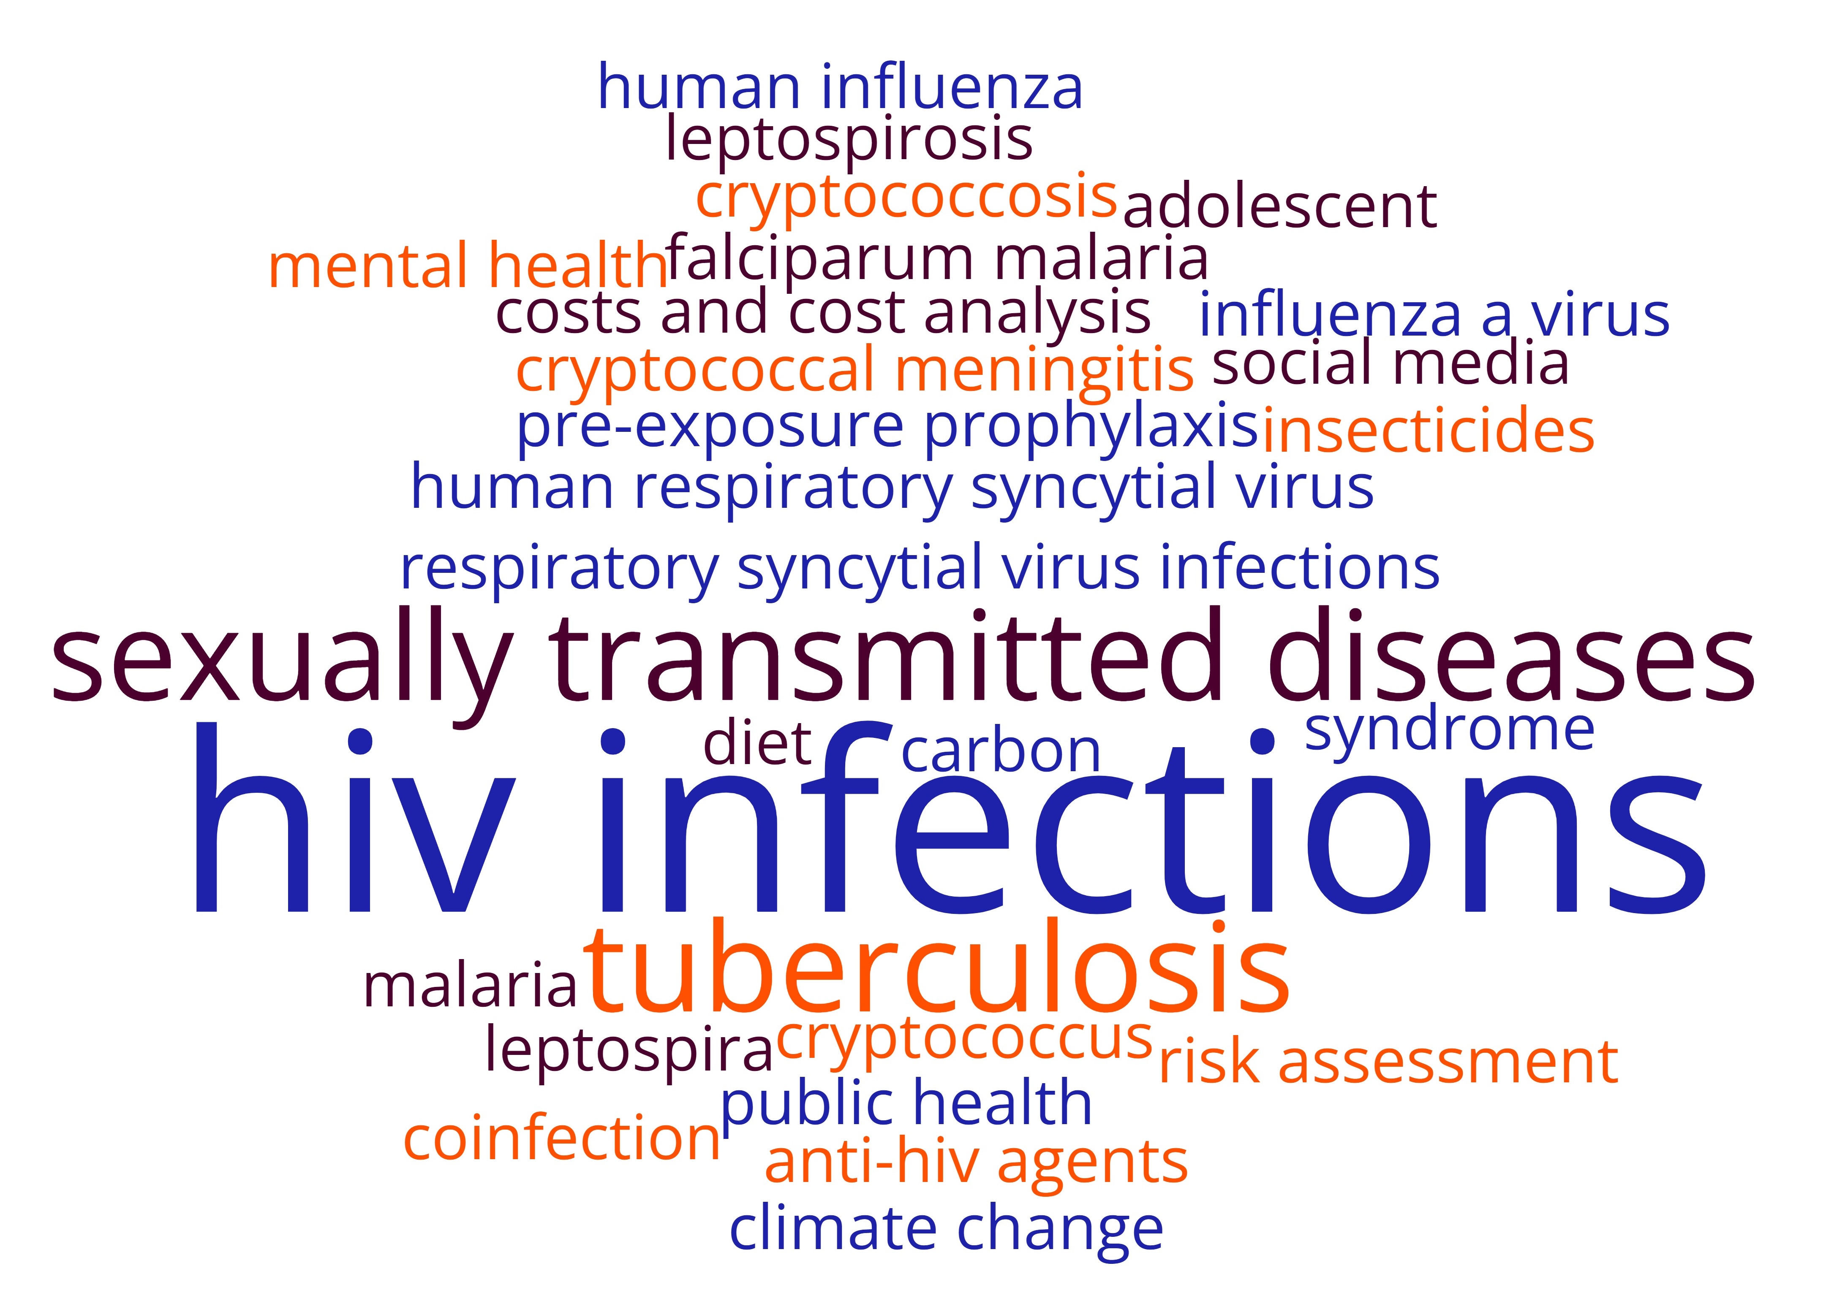
10 systematic reviews included in the study
Notes:
These were all done by research groups at LSHTM so they have a public health focus. This is a word cloud of their major subject headings.
10 studies were included, details at the end of the presentation. Most were focused on particular infectious diseases, but there was also one from our Centre for Planetary Health and another looking at mental health.

Slide 18
Geographical limits

Slide 19
Language limits
All included papers were published in English.
1 review stated that a potential paper was excluded at the full-text screening stage as it was in Turkish and the project team were unable to translate it.

Slide 20
Sources

Slide 21
Proportion of possible papers retrieved by each database
Notes:
I thought the previous graph was misleading as it doesn’t take into account how many reviews searched each database.
This graph looks at the proportion of possible papers found by each database. For the 4 databases that were searched in every review, the proportion in the same as the previous graph. However, when we look at the other databases, the proportions have changed. For example, although PsycInfo was only searched in one review, it indexed just under 60% of the included papers. Scopus was included in 4 reviews and indexed over 90% of included studies, however my search strategy missed approximately 20% of these.
75% (177/236) of papers were retrieved from all databases they were indexed in at the time of searching.
Highlight GIM results, KCI and SciELO.

Slide 22
Source of included papers found in only 1 database
n=52, 22%
Notes:
Embase seems to be more up to date than other databases. In 5 instances, a paper was retrieved in Embase but hadn’t been added to Medline on the search date. This also includes some conference proceedings.
26 of these were from one review and made up 33% of all of the included papers.
177 papers were found in all the databases they were indexed in.
Paper found only in Africa-Wide is from the mid-90s and is a study from Kenya. It’s not in an African-based journal, but it wasn’t indexed in Medline until the year after the study was published.
Only 9 (4%) included papers not in Medline, Embase, Global Health or Web of Science
25 (11%) not in Medline, Embase or Global Health. These databases are available through HINARI for free or for very low cost to researchers in low and middle-income countries. Another way to decolonise searching is to make it easier for researchers based in poorer institutions to conduct their own reviews.

Slide 23
Impact of using more sources
Notes:
Only 9 (4%) included papers not in Medline, Embase, Global Health or Web of Science
25 (11%) not in Medline, Embase or Global Health. These databases are available through HINARI for free or for very low cost to researchers in low and middle-income countries. Another way to decolonise searching is to make it easier for researchers based in poorer institutions to conduct their own reviews.

Slide 24
Conclusions
Notes:
Our results show a mixed bag. It’s hard to argue that our three interventions to improve the diversity of included papers in systematic reviews have had any impact on the papers included in the reviews. We haven’t measured the impact of not including geographic limits, but removing language limits or expanding sources only had a tiny impact.

Slide 25

More studies needed
Notes:
Where does this leave us going forward? We are going to continue this analysis. This study only includes 10 papers so it’s impossible to generalise from these. I know others have done similar studies and it’s something we need to continue so we can start to reach a critical mass we can generalise from.
I am aware that the three recommendations we use result in the systematic review reducing limits, so increasing the number of retrieved articles and the amount of screening to do. Is this sustainable? Do we need to be more pragmatic about how realistic it is for us to be comprehensive? Particularly when the number of published studies keeps increasing.

Slide 26
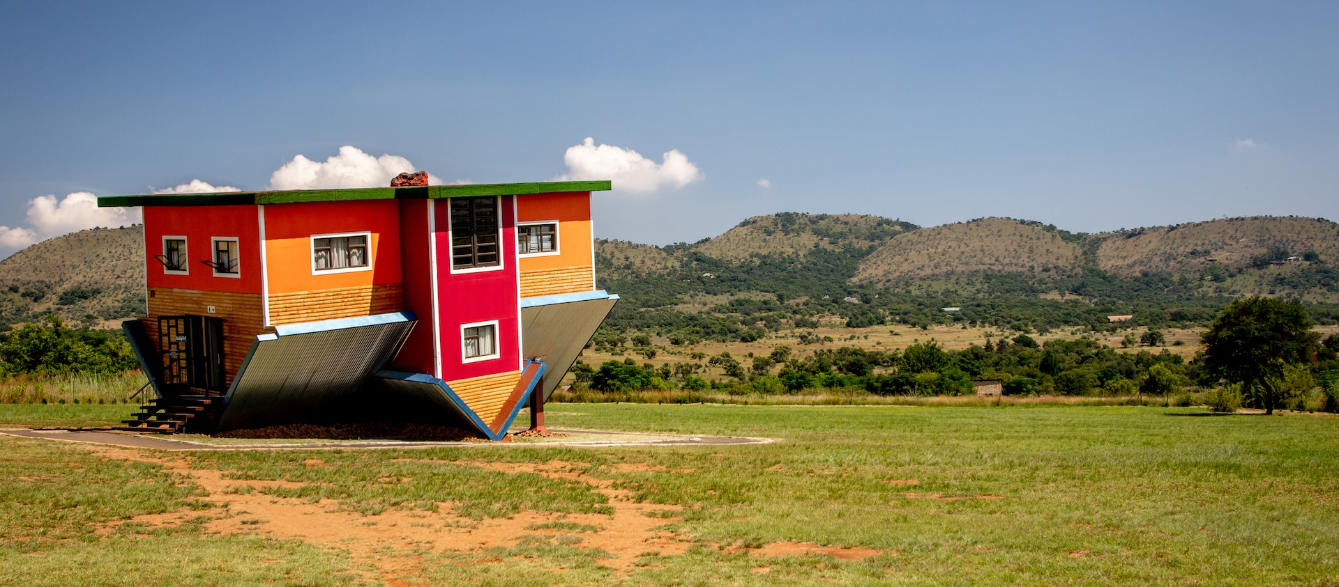
A different perspective
Number of SRs in WoS CC with an author from an institution in sub-Saharan Africa
7951/285,244 = 3%
Image: https://www.pexels.com/photo/upside-down-house-3735568/
Notes:
Maybe we can look at this from another perspective. At LSHTM we’ve been focused on how to decolonise our research, which is covering low and middle income countries and potential literature not in English. However, to really decolonise global health, we should be looking to make systematic reviews a viable methodology for any research group, anywhere in the world. Instead of a research group in London carrying out the review, maybe we should be looking at how a research group in a poorer institution than our own can complete a good quality review themselves.
Only 3% of SRs in WoS have an author from an African institution. When we limit that to SRs published in 2023, it only goes up to 4%.

Slide 27
Question for discussion
Where should we put our effort when trying to decolonise systematic review searching?
Increasing sources and reducing limits to find diverse literature
Reducing complexity so that researchers with less access to resources can complete high quality reviews
Something else?

Slide 28
Included studies
Blanchard L. et al [in press] Associations between social media, adolescent mental health and diet: a systematic review.
Burke RM, et al. What is the optimum time to start antiretroviral therapy in people with HIV and tuberculosis coinfection? A systematic review and meta-analysis. J Int AIDS Soc 2021; 24: e25772. https://doi.org/10.1002/jia2.25772
Burke RM, et al. Same-day antiretroviral therapy initiation for people living with HIV who have tuberculosis symptoms: a systematic review. HIV Med. 2022; 23: 4– 15. https://doi.org/10.1111/hiv.13169
Cuevas S, et al. Carbon pricing, health co-benefits and trade-offs: protocol for a systematic framework synthesis [version 1; peer review: awaiting peer review]. Wellcome Open Res 2023; 8:213. https://doi.org/10.12688/wellcomeopenres.18873.1
Jullien S, et al. Diagnostic accuracy of multiplex respiratory pathogen panels for influenza or respiratory syncytial virus infections: systematic review and meta-analysis. BMC Infect Dis 2022; 22: 785. https://doi.org/10.1186/s12879-022-07766-9
Loh AJW, et al. The Diagnostic Accuracy of Syndromic Management for Genital Ulcer Disease: A Systematic Review and Meta-Analysis. Frontiers in Medicine 2022:8. https://doi.org/10.3389/fmed.2021.806605
Macrae C, et al. Diagnostic performance of the IMMY cryptococcal antigen lateral flow assay on serum and cerebrospinal fluid for diagnosis of cryptococcosis in HIV-negative patients: a systematic review. BMC Infect Dis 2023; 23: 209. https://doi.org/10.1186/s12879-023-08135-w
Messenger LA, et al. Vector Control for Malaria Prevention During Humanitarian Emergencies: a Systematic Review and Meta-Analysis. Lancet Glob Health 2023; 11(4): e534–e545. https://doi.org/10.1016/S2214-109X(23)00044-X
Ong JJ, et al. Missed opportunities for sexually transmitted infections testing for HIV pre-exposure prophylaxis users: a systematic review. J Int AIDS Soc. 2021; 24(2):e25673. https://doi.org/10.1002/jia2.25673
Valente M, et al [in press] Diagnosis of human leptospirosis: systematic review and meta-analysis of the diagnostic accuracy of microscopic agglutination test on single acute-phase and paired samples, and of PCR and IgM ELISA in single acute-phase samples.

Slide 29
References
Büyüm AM, Kenney C, Koris A, et al. Decolonising global health: if not now, when? BMJ Global Health 2020;5:e003394. doi: http://dx.doi.org/10.1136/bmjgh-2020-003394.
Hirsch LA, Martin R. LSHTM and Colonialism: A report on the Colonial History of the London School of Hygiene & Tropical Medicine (1899– c.1960). Project Report. London School of Hygiene & Tropical Medicine, London. 2022. DOI: https://doi.org/10.17037/PUBS.04666958.
Nous Group. Independent review to address discrimination and advance anti-racism: London School of Hygiene and Tropical Medicine.2021. https://www.lshtm.ac.uk/media/56316.
LSHTM Equity, Diversity and Inclusion Strategy 2021-2023. https://www.lshtm.ac.uk/sites/default/files/equity-diversity-and-inclusion-strategy.pdf
LSHTM Values https://www.lshtm.ac.uk/aboutus/introducing/mission/values.
LSHTM Values Behaviour Framework https://www.lshtm.ac.uk/sites/default/files/lshtm-values-behaviour-framework.pdf.
Decolonising the Archives https://www.lshtm.ac.uk/research/library-archive-open-research-services/archives/decolonising-archives.
Lasserson TJ, Thomas J, Higgins JPT. Chapter 1: Starting a review. In: Higgins JPT, Thomas J, Chandler J, Cumpston M, Li T, Page MJ, Welch VA (editors). Cochrane Handbook for Systematic Reviews of Interventions version 6.3 (updated February 2022). Cochrane, 2022. Available from www.training.cochrane.org/handbook.
Lencucha R, Neupane S. The use, misuse and overuse of the ‘low-income and middle-income countries’ category. BMC Glob Health 2022;7:e009067. doi: https://doi.org/10.1136/bmjgh-2022-009067.
Khan T, Abimbola S, Kyobutungi C, et al. How we classify countries and people—and why it matters. BMC Glob Health 2022;7:e009704. doi: https://doi.org/10.1136/bmjgh-2022-009704.
Mason S, Merga M. Less 'prestigious' journals can contain more diverse research, by citing them we can shape a more just politics of citation. LSE Impact of Social Sciences. London: LSE, 2021 [blog]. https://blogs.lse.ac.uk/impactofsocialsciences/2021/10/11/less-prestigious-journals-can-contain-more-diverse-research-by-citing-them-we-can-shape-a-more-just-politics-of-citation/.
Levay P, Heath A, Tuvey D. Efficient searching for NICE Public Health Guidelines: would using fewer sources still find the evidence? Res Synth Methods 2022:1-30. doi: https://doi.org/10.1002/jrsm.1577.
Curry MJ, Lillis T. The dangers of English as Lingua Franca of journals: scholarship is being damaged all over the world. Inside Higher ED, 2018. https://www.insidehighered.com/views/2018/03/13/domination-english-language-journal-publishing-hurting-scholarship-many-countries.
Shenderovich Y, Eisner M, Mikton C, Gardner F, Liu J, Murray J. Methods for conducting systematic reviews of risk factors in low- and middle-income countries. BMC Med Res Methodol. 2016;16. https://doi.org/10.1186/s12874-016-0134-2.
Chaabna K, Cheema S, Abraham A, Mamtani R. Strengthening literature search strategies for systematic reviews reporting population health in the Middle East and North Africa: A meta-research study. Journal of Evidence-Based Medicine. 2020;13(3):192-8. https://doi.org/10.1111/jebm.12394.
Rockliffe L. Including non-English language articles in systematic reviews: A reflection on processes for identifying low-cost sources of translation support. Research Synthesis Methods. 2021:1-4. https://doi.org/10.1002/jrsm.1508.
Tongpoon-Patanasorn A, Griffith K. Google Translate and translation quality: A case of translating academic abstracts from Thai to English. PASAA: Journal of Language Teaching and Learning in Thailand. 2020;60:134-63.
Walpole SC. Including papers in languages other than English in systematic reviews: important, feasible, yet often omitted. J Clin Epidemiol. 2019;111:127-34. https://doi.org/10.1016/j.jclinepi.2019.03.004. LSHTM. Equitable Partnerships. https://www.lshtm.ac.uk/research/global-partnerships/equitable-partnerships.
Bethel AC, Rogers M, Abbott R. Use of a search summary table to improve systematic review search methods, results, and efficiency. J Med Libr Assoc 2021;109(1):97-106. doi: https://doi.org/10.5195/jmla.2021.809.

