Slide 1
Slow and fast change: planning the future of the University of Leeds Libraries’ student spaces
Michael Fake Associate Director: Student Learning & Experience, University of Leeds Libraries
July 2023
Notes:
"How can we be agile, adaptable, and user-led, whilst operating in University environments that can often be bureaucratic, committee-led, and ponderous? How can we balance long-term thinking with rapid change and the need for responsive development? This presentation will look at how the student expectations of our campus libraries are changing at Leeds, and how we are responding with both “fast” and “slow” approaches to improving our spaces. It will look at changes we’ve put in place recently, as well as considering how our 2030 vision Knowledge for All is informing plans for the future."

Slide 2
Library estate
c. 38,000 students
c.4,800 study spaces across five sites
Silent study, group areas, social spaces
Group spaces concentrated in newer locations: Laidlaw Library constructed 2015, Edward Boyle Library refurbished 2017, Brotherton West Building refurbished 2019
4 major stores
Art gallery and artefacts gallery

Slide 3
Library estate

Slide 4
Changing demand
2.8M turnstile entries per year pre-Covid
c.40% increase over 5 years – much faster than growth in student numbers
Notes:
Super-users are those who are using space 200+ times per year (av about 2-3 times per day during term-time).

Slide 5
Changing demand
Average student visiting libraries 24% more often than in 2015
Number of "super-users" has doubled to 8%
Notes:
Majority, average use of spaces is unchanged
Super-users are those who are using space 200+ times per year (av about 2-3 times per day during term-time).
WHY?
Pedagogy
Pressure
Accessibility of better spaces

Slide 6
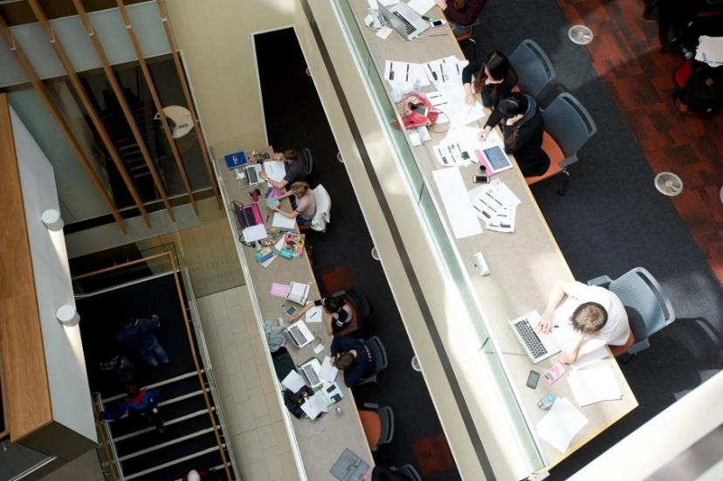
Changing demand
Demand increasing disproportionately between user cohorts
TPG individual usage up by 143%
UG usage up by 11%

Slide 7
Changing demand
Print circulation down by 85%
Ever more power and data
High quality furniture and environment

Slide 8
Changing demand
Variety of work-spaces: group study, but also single study and parallel study
Round the clock access to study space
Spaces for online engagement (?)

Slide 9
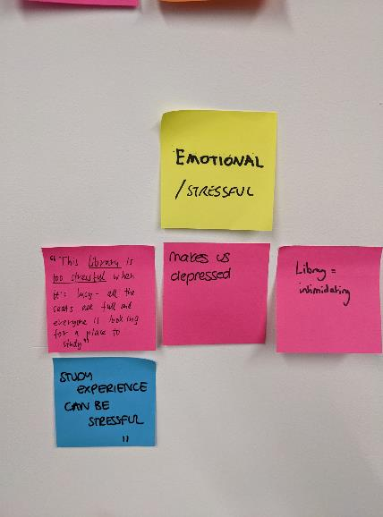
Challenges
Significant pressure on capital budgets from Carbon Net Zero, and fire safety remedial works
Uncertainty about post-Covid trends
Ownership of study space
Legacy spaces
Notes:
Legacy spaces, legacy stores

Slide 10
PRISON
OR
Library?

Slide 11
Prison or Library?

Slide 12
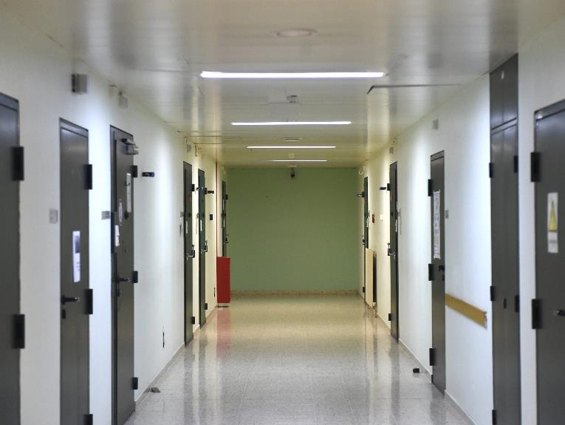
Prison or Library?

Slide 13
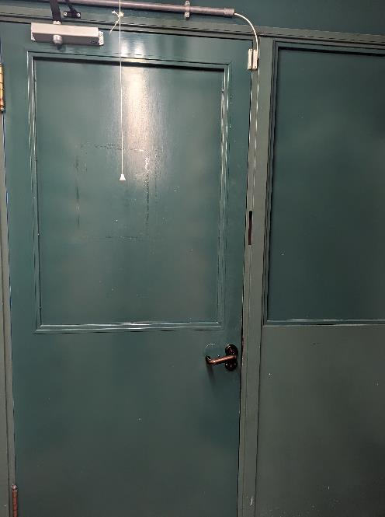
Prison or Library?

Slide 14
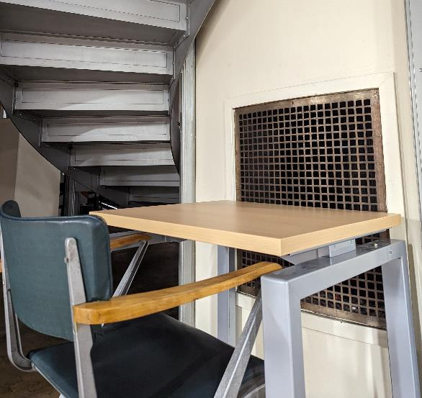
Prison or Library?

Slide 15
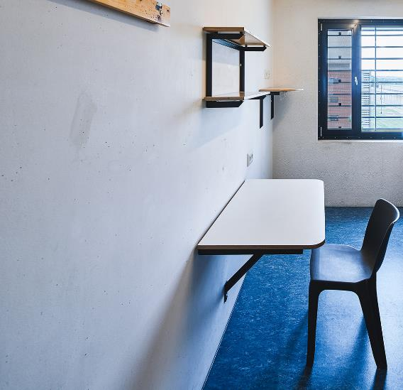
Prison or Library?

Slide 16
Prison or Library?

Slide 17
Our ambitions
2030 Vision Knowledge for All
Sustainable Environments:
Sustainability
Reconfiguring spaces to meet changing needs
Provide disruptive/creative/innovative environments
Enriched Experiences
User-led development of spaces/services
Notes:
10 year vision – so we’re thinking much longer term!
Two of the four key themes orbit around student experience / physical campus
Sustainable Environments
Environmental sustainability
Modernising existing spaces
Reconfiguring to meet changing demographics

Slide 18
Slow change
Our traditional approach
Planned
Long-term
Significant investment
Often unglamorous, unheroic, infrastructure
Notes:
Pro: bigger investment, more durable, more overall buy-in?
Con: more time for stakeholders to get cold feet; design by committee, err towards perfect rather than good-enough
WHAT IS MY OVERALL THESIS?
However real slow change is around culture to make fast change: giving permission, supporting agile approaches, staff feeling they can do things quickly.

Slide 19
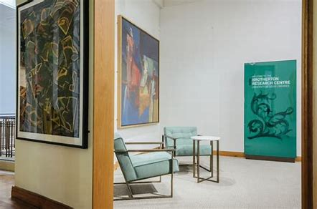
Slow change
Brotherton Research Centre

Slide 20
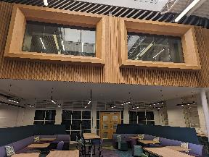
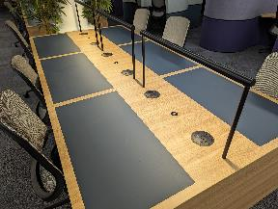
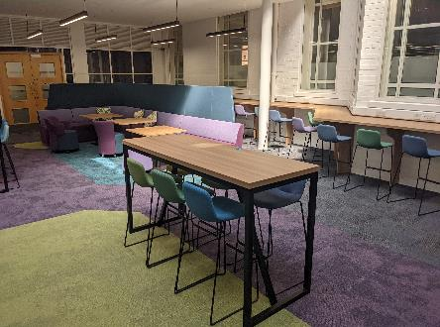
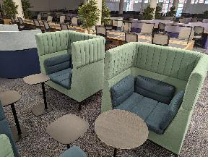
Slow change
West Building refurbishment
Notes:
WHAT IS MY OVERALL THESIS?
However real slow change is around culture to make fast change: giving permission, supporting agile approaches, staff feeling they can do things quickly.

Slide 21
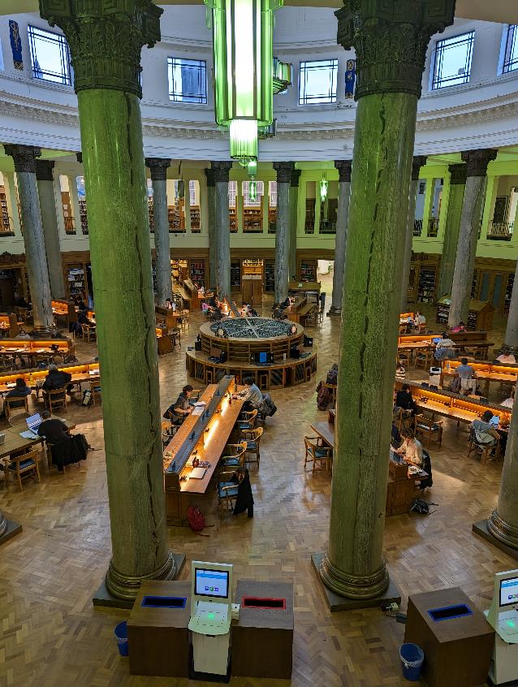
Slow change
Reading Room power & light
Institutional Storage Facility
Health Sciences ceiling grid

Slide 22
Slow change
Route to significant investment
More overall buy-in
But design by committee
Timescales can mean priorities shift
Perfect is the enemy of the good
Notes:
Image: front of the BL. Where is Parkinson Tower? Took 20 more years to build it...

Slide 23
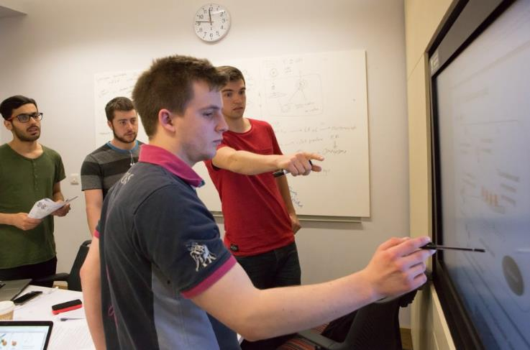
Fast change
User-led development of spaces
Prototyping
Iterative
Cheap
Fast
UX Fund to support agile development
Notes:
These are the quick and dirty solutions – experimental, prototyping, iterative, cheap (for various definitions of cheap)

Slide 24
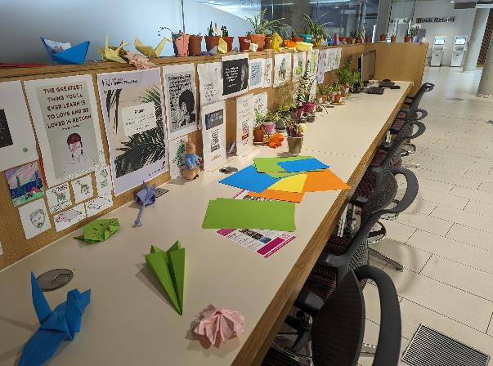
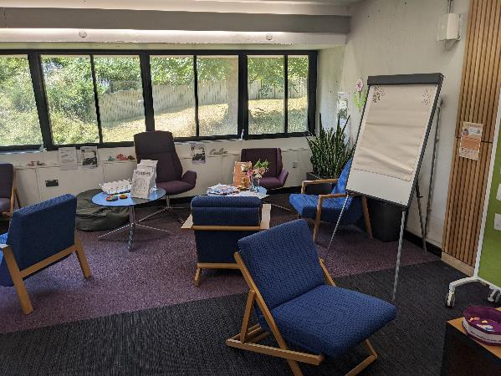
Fast change
Wellbeing spaces
Notes:
Wellbeing: scrappy, but staff love it. Place to be creative, try stuff out.

Slide 25
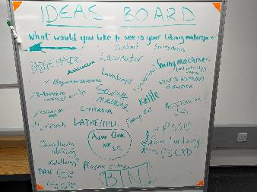
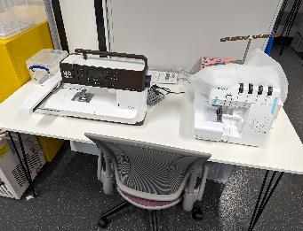
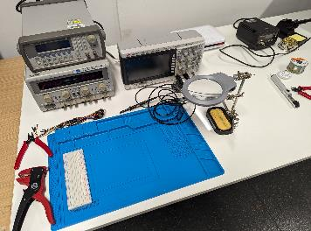
Fast change
Makerspace: Creative, experimental and entrepreneurial
Notes:
Makerspace: contrast with Helix.
Pro: quick, dynamic.
Con: still haven’t worked out future funding model, operating model, etc.

Slide 26
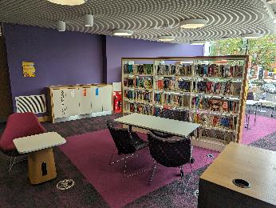
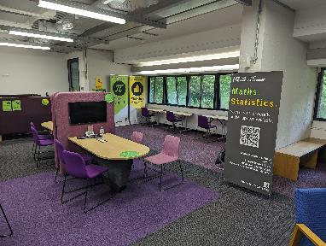
Fast change
Prayer spaces
Writing Café
'Kiosk' service point

Slide 27
Fast change challenges
Fear
Overenthusiasm
Reversion to the mean
Notes:
Fear: can I really do that?
Overenthusiasm: not checking/asking/realising consequences or impact of changes
Reversion to the mean: drift towards bureaucracy and processes and sign-offs

Slide 28
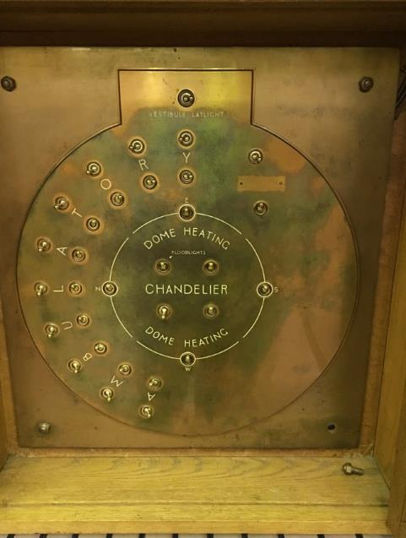
What next
Slowest change is culture change
Empower and enable staff to engage in prototyping
Teaching UX techniques
Giving permission
Letting some things break
Being clear-headed about when to be fast and when to be slow
Notes:
However real slow change is around culture to make fast change:
giving permission, supporting agile approaches, staff feeling they can do things quickly.

Slide 29
m.fake@leeds.ac.uk
Twitter: @michaelfake

