Slide 1
Designing and co-leading a credit-bearing course with faculty:
New horizons; new skills; new partnerships
Ruth Jenkins Academic Support Librarian @Kangarooth
Notes:
Introduction
I am Ruth Jenkins, from the University of Edinburgh in Scotland, where I am an Academic Support Librarian – I’m a subject librarian for medicine and biomedical sciences. I’m also a member of the UHMLG committee ☺
I’m going to talk about my experience co-leading a credit-bearing postgraduate course for the first time, in which I joined a Masters teaching team as a member of the faculty.
A big step up from being their liaison librarian, and a huge learning curve for me. Hence the subtitle ‘new horizons, new skills, new partnerships’.
First, I’ll give an overview of what we were trying to achieve with having a librarian join the programme team; then I’ll talk about designing the course and its content; how information literacy sits within this course; reflection and lessons learnt; and finishing up with what’s next.

Slide 2
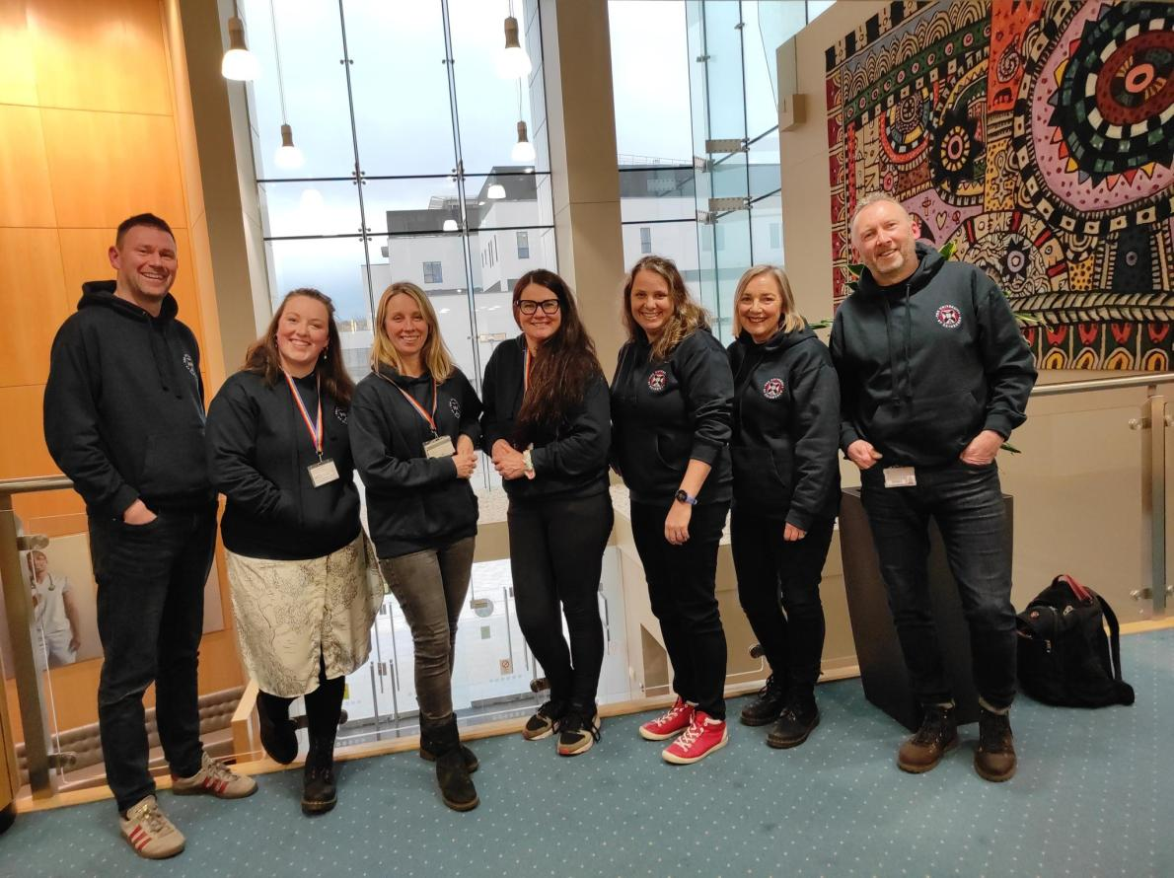
Acknowledgements
MSc Clinical Education programme team
Dr Kirstin Stuart James, Senior Academic Co-ordinator
Notes:
Acknowledgements
At this point, I would like to acknowledge the programme team of the Masters in Clinical Education,
in particular Kirstin Stuart James, who is my co-Lead on CLR which we designed and ran together, and she was very much a mentor to me throughout.

Slide 3
Jargon
Programme = Degree (Bachelors, Masters)
i.e. MSc Clinical Education
Course = module, the units of study i.e. Critical Literature Review, 20 credits
Notes:
I am going to use some jargon specific to the University of Edinburgh:
Programme = degree (i.e. masters, bachelors; MSc Clinical Education);
courses = modules i.e. what the degree is made up of.

Slide 4
Background
Notes:
Building on an existing strong working relationship between that team and University of Edinburgh librarians, in September 2022 we ran a new course called Critical Literature Review .
Not limited to a one-shot or guest lecturing on literature searching, this course involves active partnership between faculty and librarian, with information literacy woven into the fabric of the course content.
The long-term relationships created with students are some of the biggest rewards for librarians participating in classrooms, and more time spent with students can illuminate the roadblocks they encounter in research and studies [1]. But typically, librarians teaching credit-bearing courses is relatively rare, instead focusing usually on library workshops and information literacy one-shots [2].
In the UK, subject librarians are often encouraged to develop their teaching skills by gaining professional qualifications such as Fellowship of the Higher Education Academy [3], which I am myself working towards by taking a Postgraduate Certificate.
But this is at odds with that ubiquity of information literacy one-shots, whose restrictions limit the opportunity to guide students towards progressively more complex thinking and practice [4] such as application, analysis, synthesis or evaluation [3].
As a librarian joining the teaching team for Critical Literature Review was an opportunity for myself to gain teaching experience, and to embed information literacy within the curriculum.

Slide 5
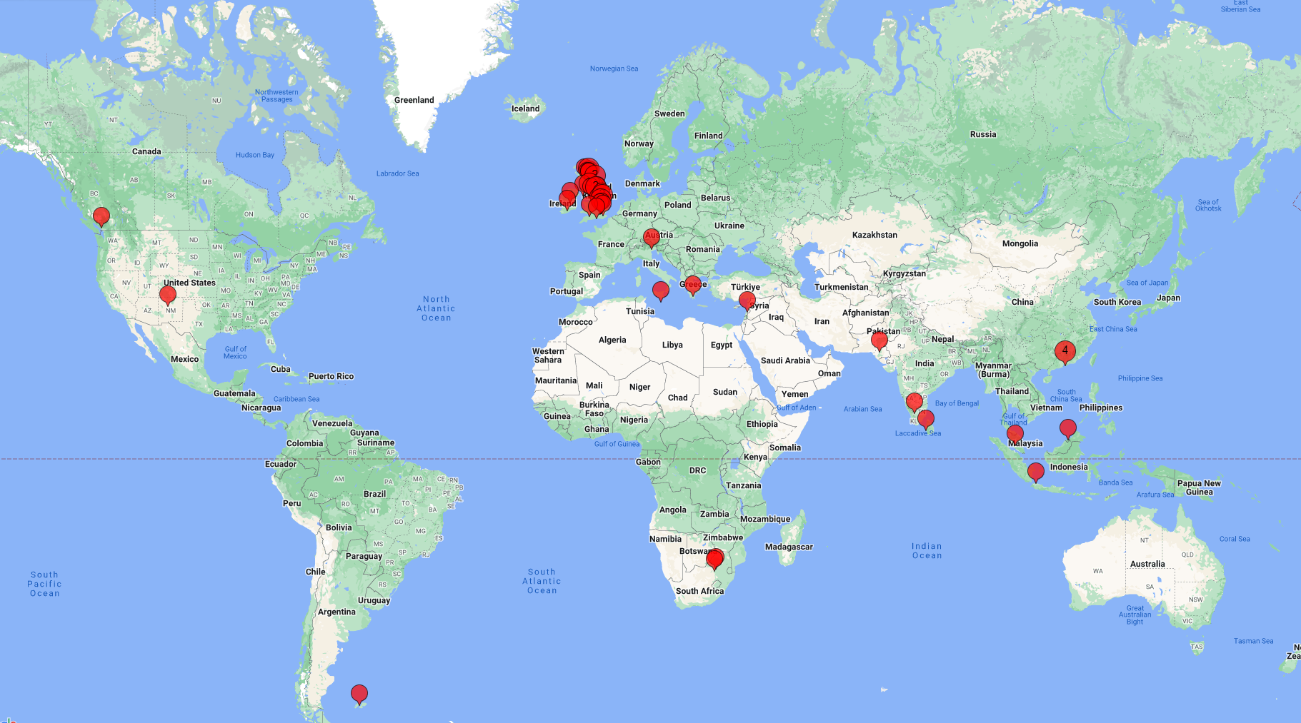
MSc Clinical Education
Online distance learning Masters
Part-time over 3 years
Global cohort of health professionals
Notes:
The MSc and the course – an overview
MSc Clinical Education
Online distance learning Masters, which students study part-time over 3 years
Medical and health professionals such as doctors, nurses, dentists, vets etc
And they are a truly global cohort.
Existing relationship - I am their named librarian, and have been for 6 years.
I meet with students and answer their queries, start-of-term induction sessions, literature searching workshops, attend Board of Examiners, and even co-supervised a dissertation.

Slide 6
The course – Critical Literature Review
By the end of the course you will be able to:
Investigate a problem through critical literature review.
Design and implement a systematic search following a methodological framework.
Organise and critically analyse retrieved research evidence.
Synthesise research evidence from disparate sources.
Critically reflect on learning in relation to critical literature review.
Notes:
The course – Critical Literature Review
Learning outcomes:
Investigate a problem through critical literature review.
Design and implement a literature search.
Organise, critically analyse, and synthesise research evidence
Critically reflect on learning.

Slide 7
Designing and delivering the course

Slide 8
The course – Critical Literature Review
Asynchronous over 10 weeks
20 credits = 200 hours
Workbook, virtual learning environment (weekly activities, readings, discussion forums) and optional ‘live conversations’
110 hours of my time
Notes:
Asynchronous over 10 weeks – students expected to spend 200 hours on the course.
Workbook, VLE (weekly activities to encourage active learning, readings, discussion forums)
with optional weekly Live Conversations on Microsoft Teams – essentially tutorials, but ‘live conversation’ sets up more equal relationship [5]
My time bought out by the programme team
Approx 110 hours – including design, so I expect it to be less next time (this September to December).
During term-time, essentially I was working 4 days of the week in my librarian work, 1 day on the course. But, the work spread out across different days.
We used constructive alignment – essentially means starting with the learning outcomes and working backwards to write course content and assessment that meets those outcomes.
Actually found it a little bit easier to be asynchronous and online – the bulk of the work was done over the summer – I hesitate to say “at our leisure”, but it was less pressure to have asynchronous work with informal live conversations than if I had to stand at the front of a classroom.

Slide 9
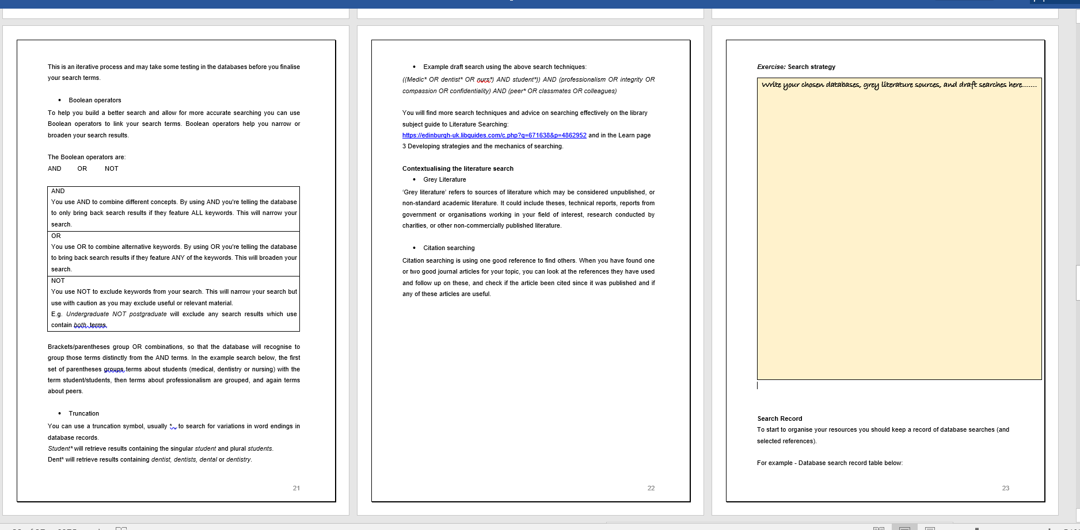
Workbook
This is a title
This is a subtitle
Notes:
The course content over the 10 weeks follows the literature review process.
Although 10 weeks & ~10 stages, can work through at own pace within that 10 weeks.

Slide 10
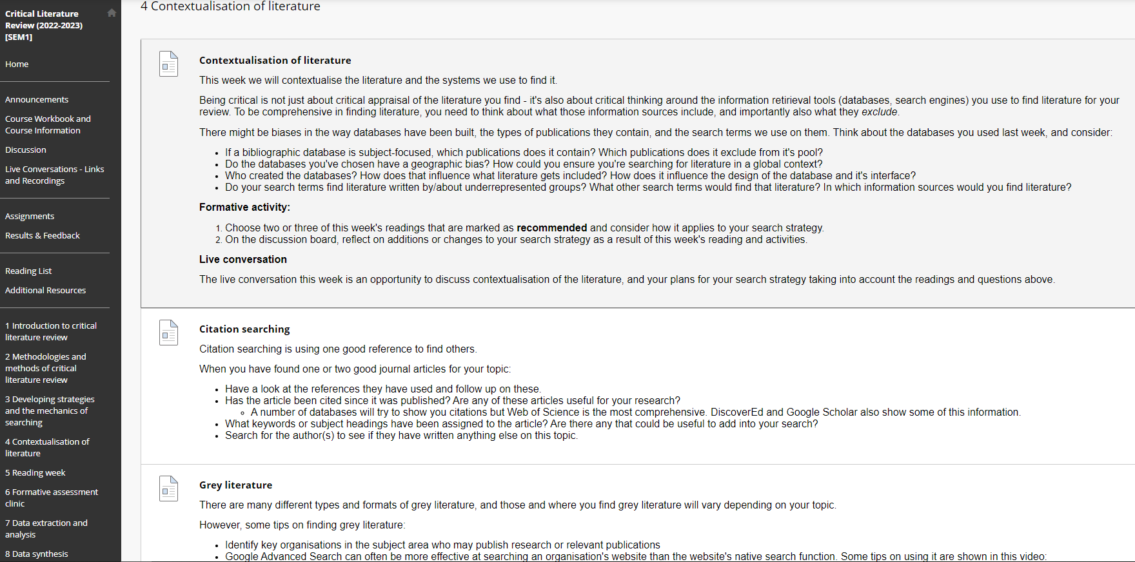
Virtual Learning Environment
This is a title
This is a subtitle
Notes:
One week on developing literature search strategies, one week on refining and contextualising search strategies which included bias/information privilege/construction of authority [6].
Refining searches, but also thinking critically about the products we use to find and access information, how is authority constructed in publications?
e.g. from weekly activity - We ask the students to consider things such as:
Do the databases you've chosen have a geographic bias? How could you ensure you're searching for literature in a global context?
Who created the databases? How does that influence what literature gets included? How does it influence the design of the database and it's interface?
Do your search terms find literature written by/about underrepresented groups? What other search terms would find that literature? In which information sources would you find literature?
Information literacy and criticality permeates the design of CLR, and a critical stance is encouraged in students towards not only the literature for review, but to the overall process and systems used.
For example, interrogating power structures in using databases, who is deciding what counts as valid knowledge, and approaches to minimising bias [7].
Direct involvement of a librarian from inception through delivery of the course provided opportunities to embed information literacy in the fabric of the course.
However, to be completely honest, I’m not sure how successful it was. I think I was a bit naïve that all the students would start critically engaging, when they are only just getting to grips with the basics of how to do a literature review.
That was certainly reflected in the topics of discussion in the live conversations, which were more procedural and assignment-focused.

Slide 11
Assessment
Notes:
We have two assessments: : a formative assignment (optional, about halfway through, ungraded but feedback provided) and summative assignment (final piece of work, grades given, marked against marking criteria)

Slide 12
Formative – Annotated search plan
Summative – Critical Literature Review of 3000 words
Notes:
Formative – week 5, halfway through. Annotated search plan [show template] with prompt questions.
Summative – Critical Literature Review of 3000 words, following suggested sections with guided word counts, including a reflection on their learning and on critical literature review methods.

Slide 13
Formative assignment template
What is your title?
What do you hope to find out?
What are your key concepts? (You can use a question framework here if useful, e.g. SPICE, PICO)
What are your inclusion/exclusion criteria?
What date range will your search cover, and why?
Which databases will you search and why?
Which sources of grey literature will you search and why?
What search terms will you use? Include a draft search, with terms combined using Boolean operators, and any appropriate search techniques (e.g. truncation, subject headings)
Do you anticipate any problems with finding literature, and what steps might you take in response?
Notes:
I’m going to talk about the formative assessment because I think it I of most interest to this audience.
The students are asked to fill out a search plan template, with question prompts, including ‘why’; for example, ‘which sources of grey literature will you search and why?
It’s a simple question, just one word ‘why’, but it begins to address application of competencies and critical thinking. [9]
Formative assessment acts as assessment of learning (have they understood?), and assessment for learning (are there themes or common issues to discuss in the live conversations? Something not clear? I can adjust) [8]
By engaging with the formative assessment, the student will not only do the basic literature search elements that the template addresses, but also consider how they interact together and with the student’s own research topic [10].
In their answer to the ‘why’ part of the question, from their explanations we can see if they have understood these search planning aspects and their critical thinking behind their choices.

Slide 14
Practice time!
Notes:
Marking and feedback was completely new to me, and I was nervous of the responsibility. Maybe you would be too?
Well, practice makes perfect so let’s have a go together.
Fictitious formative assessment (apologies to author). You are going to be reading through this two times, and have a go at providing some feedback.

Slide 15
1. First read through - assessment of learning
have they understood the course material?
2. Second read through – assessment for learning
Feedback (feedforward) comments to help them with working towards the summative assignment
2 strengths + something to strengthen/think about.
Positive language
Notes:
First time, read through. We’re thinking about assessment of learning – have they understood the course material.
Our second read through will be looking at assessment for learning, but we’ll get to that. For now, read through and discuss your first thoughts, things that you want to comment on.
We don’t have much time, so just focus on a few elements of the table. I know it’s a bit difficult because you yourselves don’t know the course material, so maybe focus on the search-related parts.
[discussion - Not really about correction, it’s about reassurance. Were there parts that were strong (might be focused on negative)]
Second read through – assessment for learning
- Feedback (feedforward) comments to help them with working towards the summative assignment
- 2 strengths + something to strengthen/think about. Low-hanging fruit.
Positive language, not “this was weak”. You don’t want the students disheartened!
[call on volunteers, or pick a few]

Slide 16
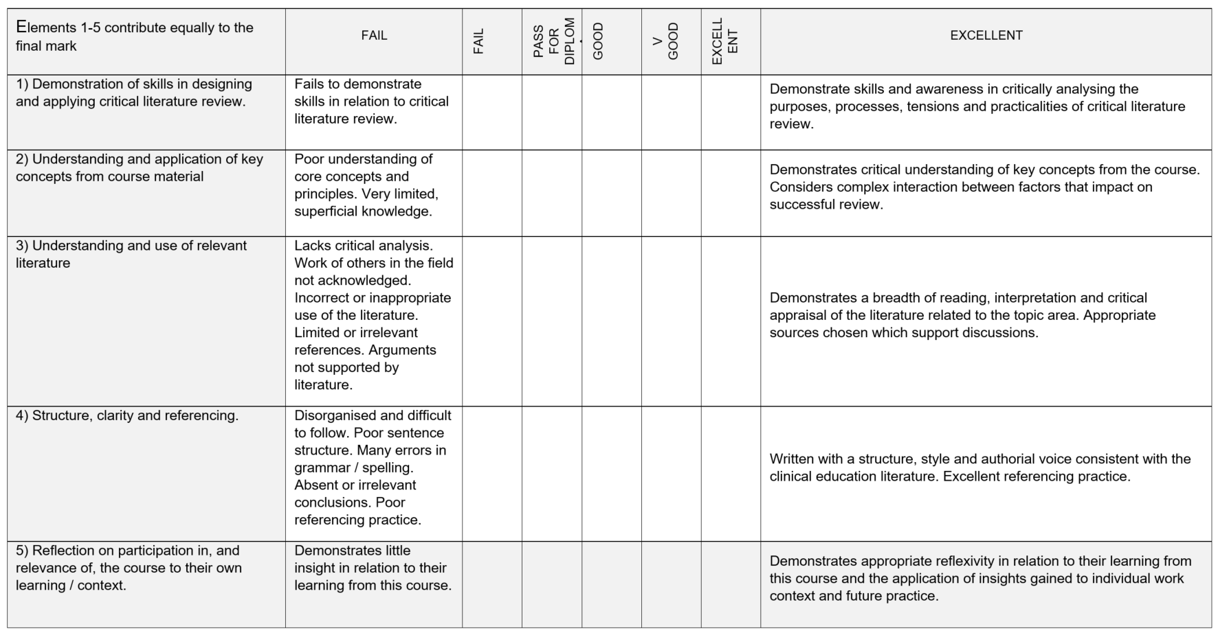
Summative assignment grading criteria
Notes:
Summative assessment was much more structured with grading criteria.
Marking is subjective:
Some ways to minimise bias: The co-lead and I double marked three scripts to calibrate our marking in terms of this matrix.
we had a moderator marker.
It took me several hours to do one. Average for my more experienced co-lead was 45 minutes.
Personal reflection on this: I have high standards, particularly for the literature search strategies. I had to remind myself a Masters is about learning to master, there will still be mistakes in eg referencing, they haven't learned it all yet.

Slide 17
What’s next?
Notes:
Changes?
Running again 2023-24

Slide 18
Review and update
New VLE
Scoping review co-author (pending funding)
Notes:
Not a lot to change course content, just tweaks
Learn Ultra
Do some work on this but should be a more streamlined experience for the students
Scoping review on pathways – applying for a grant, will do the lit search and be co-author.

Slide 19
Reflection and lessons

Slide 20
New roles and skills
Teaching experience
Partnership with faculty
“infiltrating” faculty (Cowan & Eva 2016)
Notes:
New roles and skillsets
Really good timing for me because started a Postgraduate Certificate in Academic Practice, a teaching qualification run by UoE. I was able to start implementing my learning from the PGCert, and as the assignments were reflective I was able to use CLR in those.
Did I enjoy it? Yes, but…
Would I do it again? Yes, but…
I would think carefully before taking on another course like this.
Although they bought out my time it was still a lot of work and very tiring. 1 hour of thinking and creating and writing and learning, does not equal 1 hour of routine library work.
The next iteration will be easier because the course is already written.
Partnership with faculty
There is a potential new role for librarians in what Cowan and Eva (2016) call ‘infiltrating’ faculty [11]. Not being a traditional ‘library’ course, Critical Literature Review demonstrates that librarians are teachers not limited to ‘library’ content, and that it is not only librarians who can and should teach information literacy [11] to empower university students to think critically and make balanced judgements about information [9].
Whether or not my attempts to integrate critical information literacy into the course are successful or not, it’s surely better than a one-shot – these are students I would’ve seen for a one-shot anyway, and this is already so much more time with them.
By being there at the live conversations and in the discussion boards and reading their assignments, I was able to weigh in and raise information literacy related things throughout the course.

Slide 21
Thank you
Notes:
Conclusion
Designing and leading a credit-bearing course is a big commitment but when undertaking with open eyes is an opportunity for valuable experience and partnership.
Thank you.

Slide 22
References
Bovill, C., J. Jarvis and K. Smith (2020). Co-creating Learning and Teaching : Towards relational pedagogy in higher education. St Albans, UNITED KINGDOM, Critical Publishing.
CILIP Information Literacy Group (2018). CILIP Definition of Information Literacy 2018.
Cowan, S. and N. Eva (2016). "Changing Our Aim: Infiltrating Faculty with Information Literacy." Communications in Information Literacy 10(2).
Drabinski, E. (2022). Structure and Power: Information Literacy for Liberation. LILAC: The Information Literacy Conference. Manchester Metropoloitan University.
Earl, L. M. (2012). Assessment As Learning: Using Classroom Assessment to Maximize Student Learning. Thousand Oaks, Corwin Press.
Holderman, S. (2021). "A perspective on librarians as unexpected teaching faculty: The imperative of clear policy." The Journal of Academic Librarianship 47(4): 102343.
Krathwohl, D. R. (2002). "A Revision of Bloom's Taxonomy: An Overview." Theory into practice 41(4): 212-218.
Meyers, N. M. and D. D. Nulty (2009). "How to use (five) curriculum design principles to align authentic learning environments, assessment, students’ approaches to thinking and learning outcomes." Assessment & Evaluation in Higher Education 34(5): 565-577.
Nowlan, G. (2013). "Not Playing Second Fiddle: A Librarian as Adjunct Professor for a University Music Department." CAML Review/Revue de l'ACBM 41(2).
Stebbing, D., J. Shelley, M. Warnes and C. McMaster (2019). "What academics really think about information literacy." Journal of information literacy 13(1): 21.
Tewell, E. (2020). "The Problem with Grit: Dismantling Deficit Thinking in Library Instruction." Portal (Baltimore, Md.) 20(1): 137-159.
Notes:
Course feedback
Informal feedback was positive. This was received through informal discussion during live conversations. More formally a positive response was reported at the Student-Staff Liaison Committee. In addition, a Critical Literature Review student survey was returned.
Student survey
Response rate: 4/43 = 9.3%
Overall quality of the course rating: Overall, the course was rated well with ratings approximating 8/10.
Any suggestions for improvement? If so, what:
This was the first iteration of the course. As such previous examples of work were not available to the 2022-23 cohort. This was mentioned in the student response and will be taken forwards for 23-24.
Other free text comments you wish to include:
Free text comments were encouraging and of note were that the course is relevant to practice, there was flexibility in delivery, and faculty are responsive. Students reported they felt prepared to undertake a CLR in future.

